Slide 1
V THREE COLLABORATIVE PILLARS
V.3 (Thu March 28) Gesture Theory (3)

Slide 2
Gestoids: From Gestures to Symbols
Algebraic Topology
homotopic
curves
X

Slide 3
The Fundamental Group
X
0
1
0
1
0
1
composition of homotopy classes of curves is associative (a.b).c = a.(b.c)
⇒ have fundamental group π₁(X) = {homotopy classes of loops at a fixed point} + composition

Slide 4
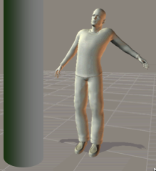
Which groups are fundamental groups π₁(X)?
Ÿ integers?
i—
Ÿ₁₂ (pitch class group!)? Yes!
all groups? Yes!
i
e^{i2πt}
g:
1
—
X = S¹
π₁(S¹) = Ÿ

Slide 5
π₁(X) = Ÿ_{n}?
action of Ÿ_{n}
S²
Ÿ_{n}
1
lense space L_{n,1}
π₁(L_{n,1}) = Ÿ_{n}

Slide 6
The homotopy classes of curves of a gesture g define the Gestoid G_{g} of a gesture g.
This consists of the linear combinations with complex coefficients Σ_{n} a_{n}c_{n}, e.g. 3.5 c₁ – 2 c₂ of homotopy classes c_{n} of curves between given points x, y of gesture g.
too abstract?
x
y

Slide 7
π₁(S¹) = Ÿ
e^{i2πnt} ~ n
i—
i
e^{i2πt}
g:
1
—
fundamental
3rd partial
X = S¹
2nd partial
4th partial
a₁ e^{i2πt} + a₂ e^{i2π2t} + a₃ e^{i2π3t} + a₄ e^{i2π4t}
Σ_{n} a_{n} e^{i2πnt}
~ Fourier formula f(t) = Σ _{n} a_{n} e^{i2πnt}

Slide 8
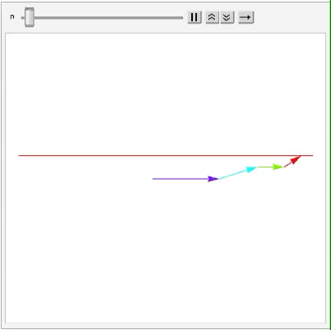
Fourier ballet
F
2F
3F
4F
QED

Slide 9
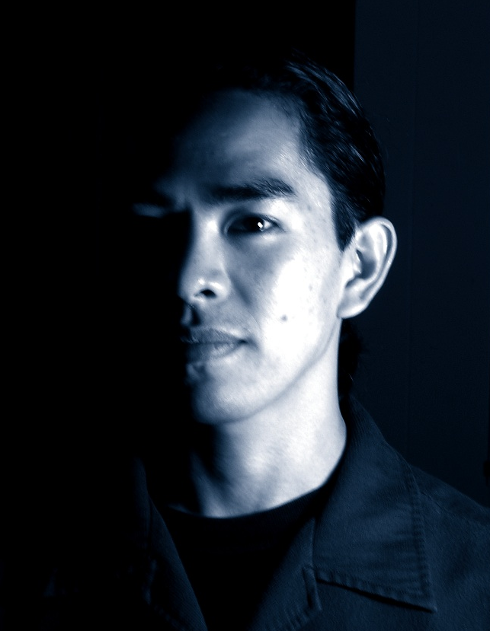
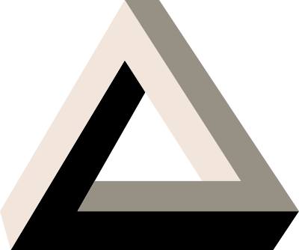
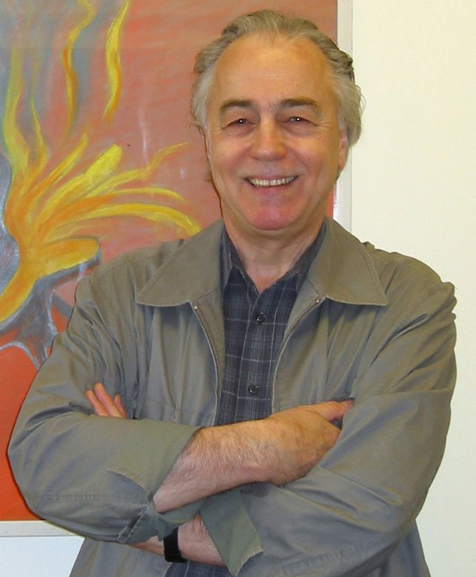
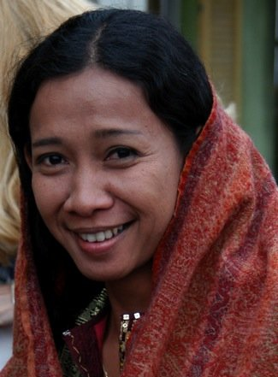
We are working on the collaborative project Dancing the Violent Body of Sound
I am Schuyler Tsuda a music student in composition
What?
I am William Messing a math faculty
I am Diyah Larasati a dance faculty

Slide 10
