Slide 1
IV THREE COLLABORATIVE PILLARS
IV.2 (Thu Feb 29) John Coltrane: Ascension

Slide 2
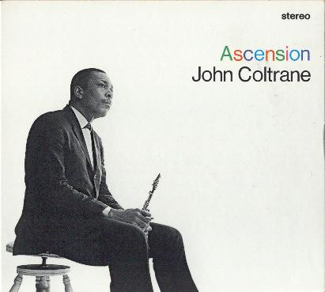
John Coltrane ts
Pharoah Sanders ts Archie Shepp ts Marion Brown as
John Tchicai as
Freddie Hubbard tp Dewey Johnson tp McCoy Tyner p Art Davis b
Jimmy Garrison b
Elvin Jones d
recorded at the Van Gelder Studio, Englewood Cliffs, NJ June 28, 1965
Ascension Edition II 40:32 (Ascension Edition I 38:37)
From liner notes: To begin at the beginning, a caveat for the casual listener. Be advised that this record cannot be loved or understood in one sitting, and that there can be no appreciation at all in two minutes listening to an arbitrary excerpt in a record store. (...) Marion Brown described the session as „wildly exciting. We did two takes, and they both had that kind of thing in them that makes people scream. The people who were in the studio were screaming.

Slide 3
0:00 „modal spectrum“ 3:10
3:10 Coltrane 2:40
5:50 „modal spectrum“ 2:00
7:50 Johnson 1:46
9:34 „modal spectrum“ 2:22
11:56 Sanders 3:32
14:28 „modal spectrum“ 1:13
15:41 Hubbard 2:02
17:43 „modal spectrum“ 1.11
18:54 Brown 1:07
20:03 „modal spectrum“ 1:14
21:17 Shepp 2:59
24:16 „modal spectrum“ 1:00
25:16 Tchicai 2:06
27:22 „modal spectrum“ 2:37
29:59 Tyner 3:29
33:28 basses 2:28
35:56 „modal spectrum“ 4:36
40:32 end total: 22:09 18:23
hounted

Slide 4
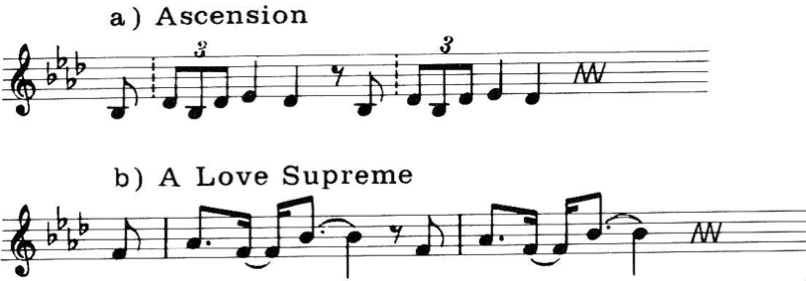
modal spectrum: B_{flat}maj triad „arpeggiated by modes“
11
0
1
11
0
1
11
0
1
11
0
1
10
2
10
2
10
2
10
2
9
3
9
3
9
3
9
3
8
4
8
4
8
4
8
4
7
6
5
7
6
5
7
6
5
7
6
5
B_{flat} aeolian
D_{flat} scale
D phrygian
B_{flat} scale
F phrygian
D_{flat} scale
B_{flat} aeolian
D_{flat} scale

Slide 5
Closed Spaces — Open Spaces
Closed Spaces
populate given spaces such as
tonalities/cadences/modulation
consonances/dissonances
32 song/ blues scheme
sonata scheme...global forms
conductor‘s baton
a-1, a-2, a-1, 2, 3, 4...
etc.
Open Spaces
transcend given spaces (Sirone: „one octave higher“) via
variation of spaces (e.g. scale/chord types: ToM lists, example: chromatic chord {c, c#, d} with 23 (!) 3rd ext.)
extending spaces (Folia #3: beginning)
negation of the space limits (Monk: C/D)
suspending structures/rules (Evans: dialog)
exchanging roles of parameters (tuning...)
creating empty spaces (#7 CD: 5:26)
etc.
Collaborative principle for open space creation/negotiation:
Be constantly aware of the musicians‘ positions in those spaces in order to enable them to unfold with a maximal relief and collaborative presence.

Slide 6
ionian, dorian, phrygian, lydian, mixolydian, aeolian, locrian
chords of modal spectra

Slide 7
Coltrane
Brown
Tyner
B_{flat}maj modal triad
Hubbard
Sanders
Tchicai
Shepp
Johnson

