Slide 1
III THE LANDSCAPE OF FREE JAZZ
III.4 (Thu Feb 22) The art of collaboration (Setting up the conceptual framework)

Slide 2
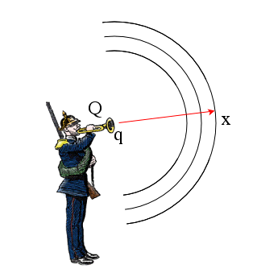

Slide 3
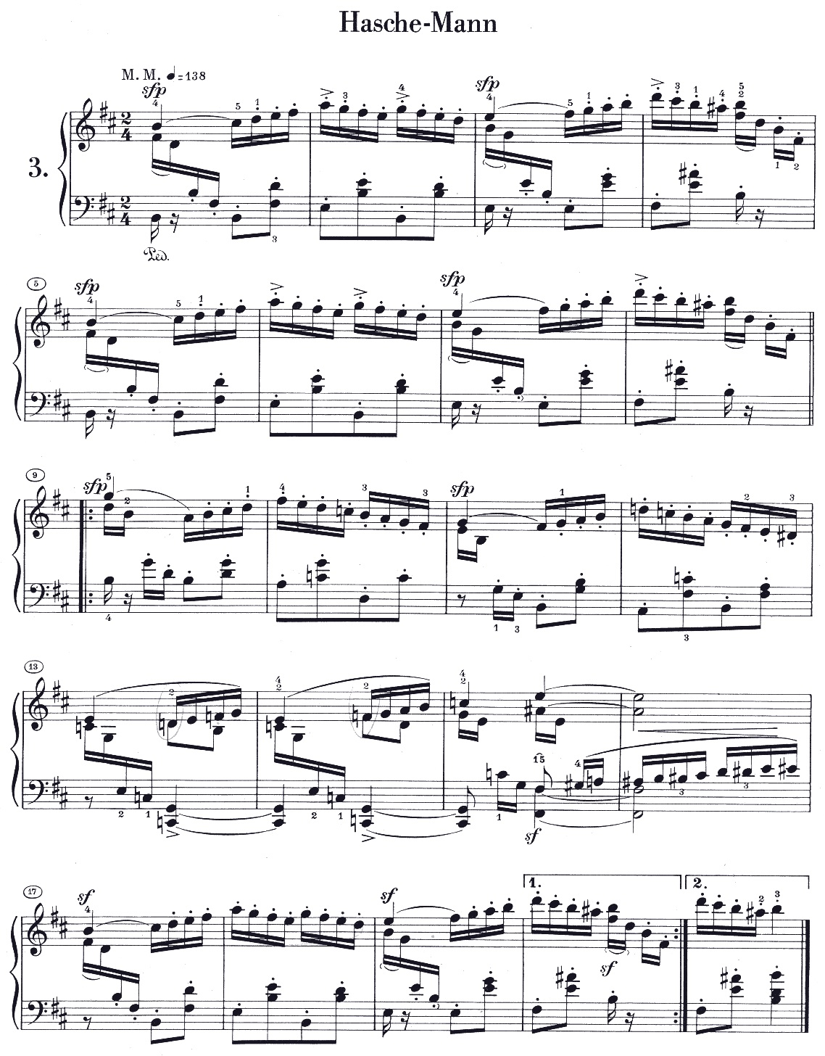
hounted

Slide 4
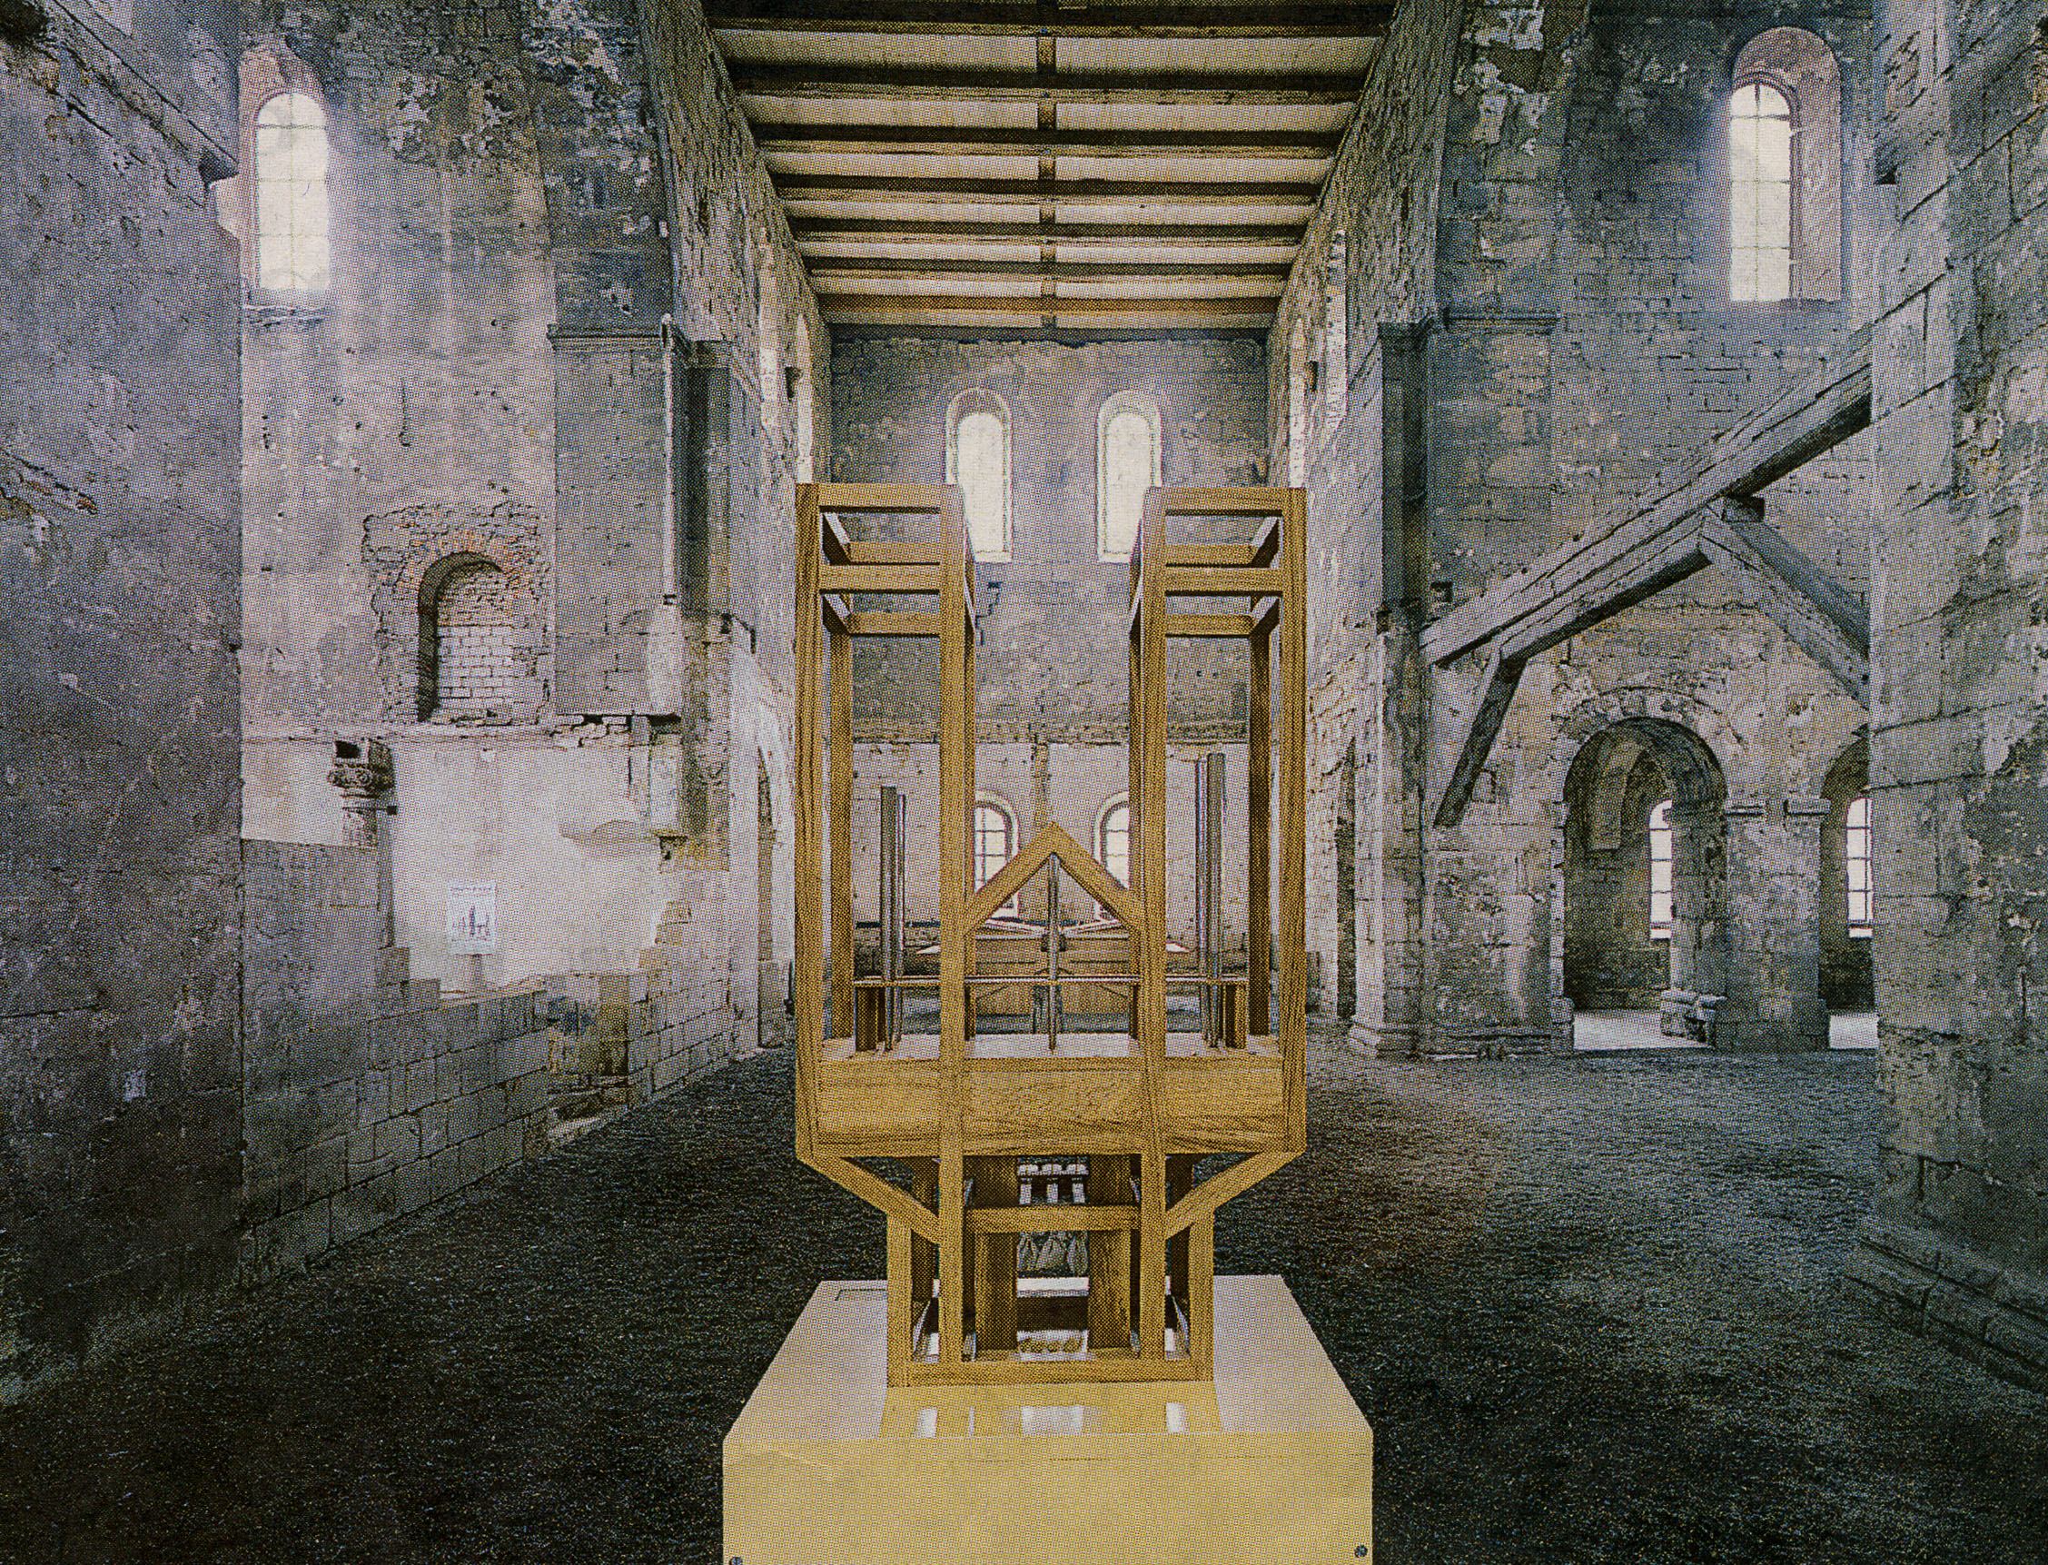
John Cage: ASLSP (https://universes.art/en/specials/john-cage-organ-project-halberstadt)

Slide 5
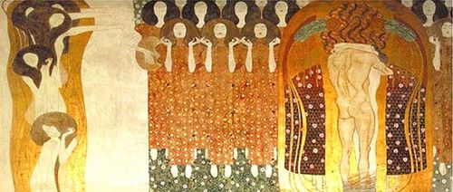
Gustav Klimt: Beethoven Frieze

Slide 6
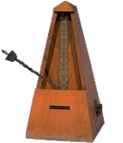
Mental
Physical
℘
Psychic

Slide 7
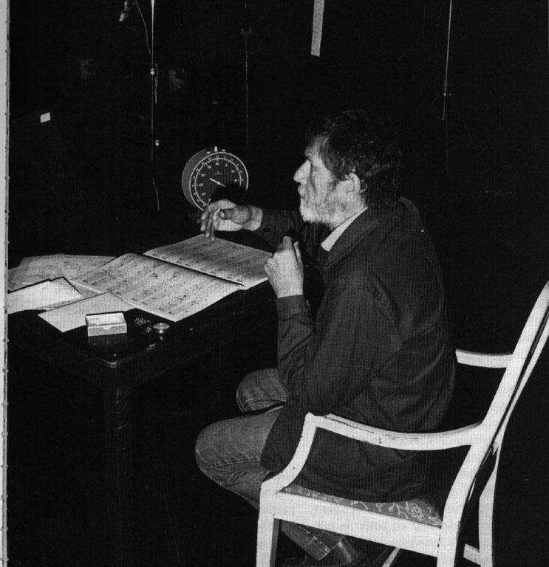
Poiesis: Arnold Schoenberg/John Cage

Slide 8
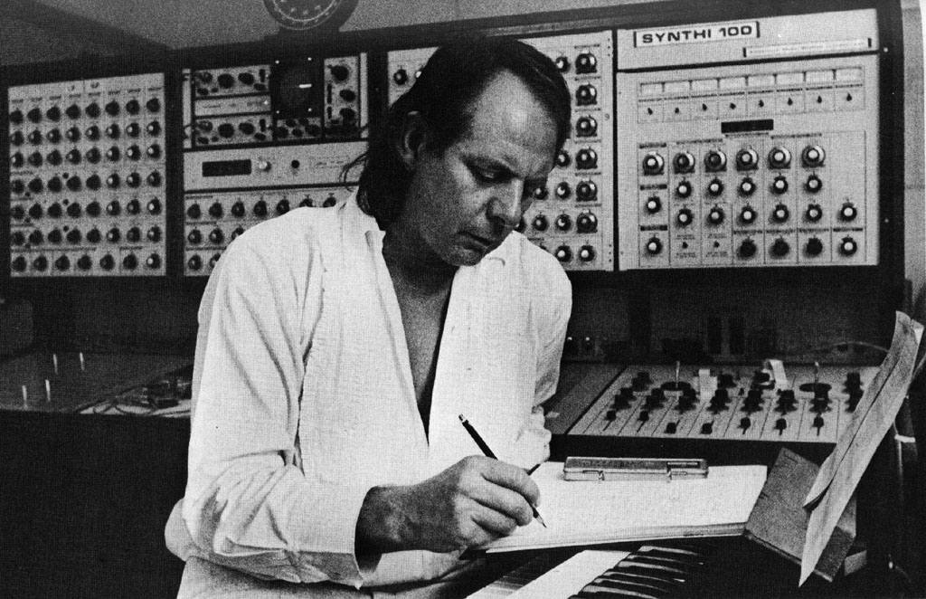
Poiesis: Stockhausen

Slide 9
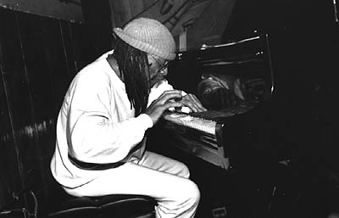
Poiesis: Cecil Taylor/Peter Broetzmann

Slide 10
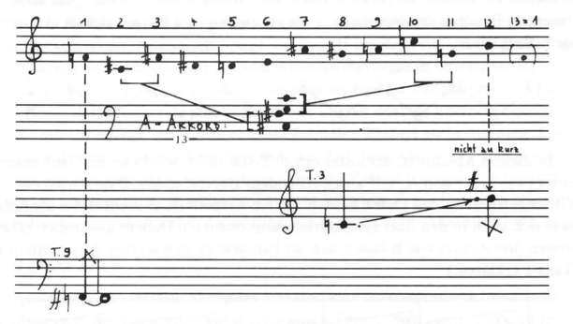
Poiesis: Karlheinz Stockhausen Klavierstück IX

Slide 11
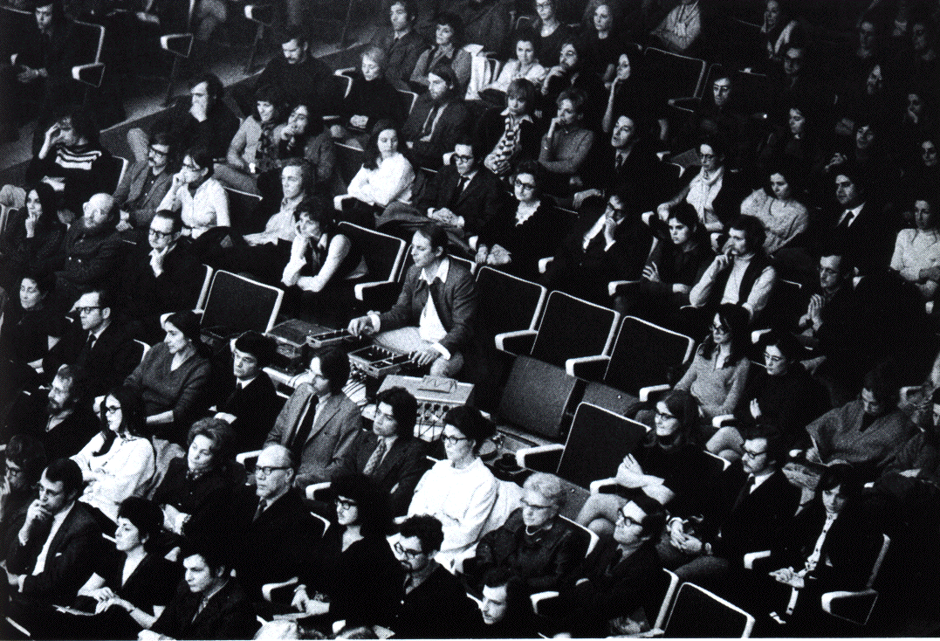
Aesthesis: with Stockhausen

Slide 12
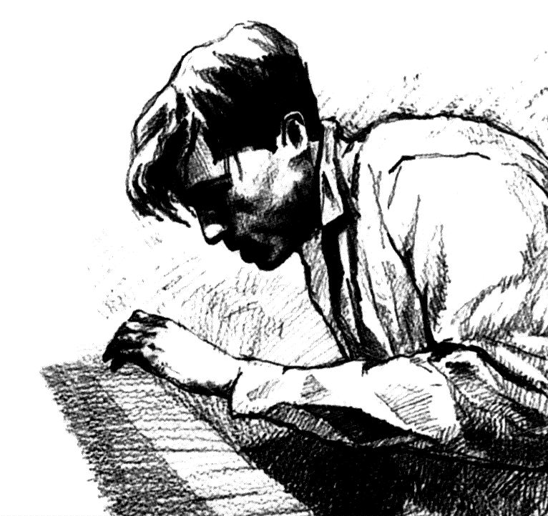
Aesthesis: Performance/Interpretation

Slide 13
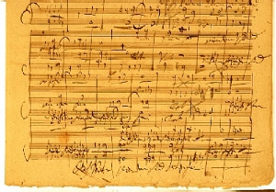
Communication
Poiesis
Neutral Niveau
Aesthesis
Jean Molino, Paul Valéry, Nicolas Ruwet, Jean-Jacques Nattiez

Slide 14
Semiotics
Sign
Expression
Signification
Content
!
„Firework“
aliquid
pro
aliquo

Slide 15
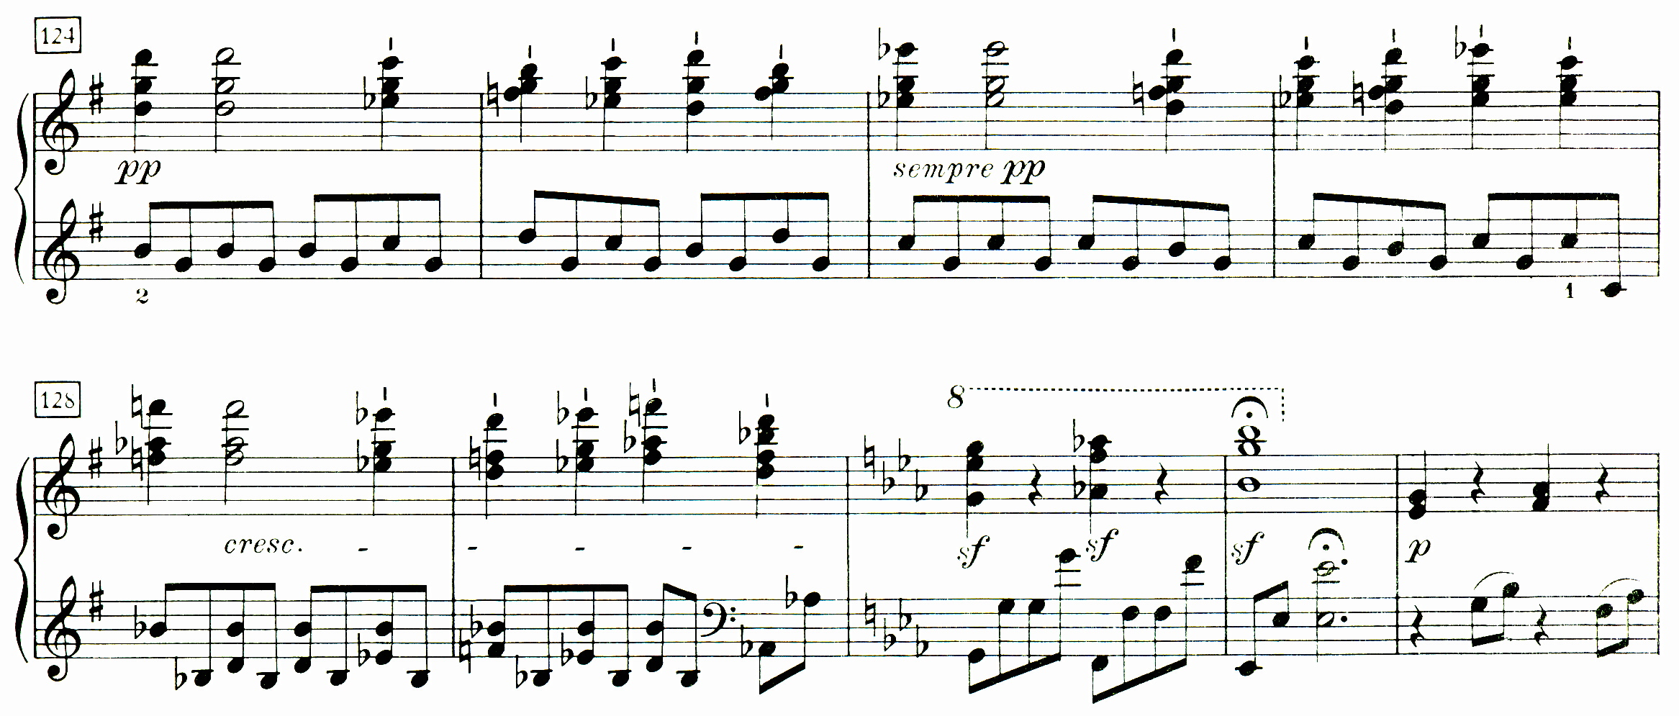
Expression
„score surface“
Signification
harmonic analysis
Content
tonal modulation G _{maj} → E-flat _{maj}
Sign

Slide 16
Communication
Poiesis
Neutral Niveau
Aesthesis
Physical
Mental
Psychic
Content
Realities
Signification
Expression
Sign

Slide 17
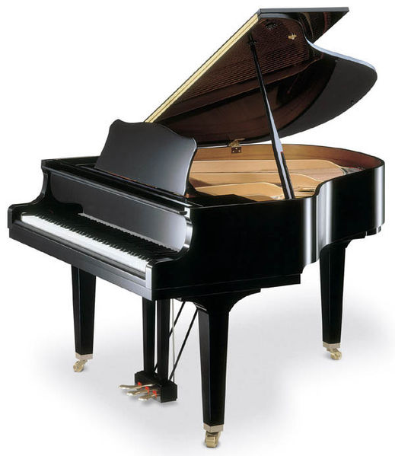
The Ontology of Music
expression
signification
content
signs
physical
psychological
symbolic
realities
communication
poiesis neutral level aesthesis

Slide 18
Teak Leaves at the Temples

Slide 19
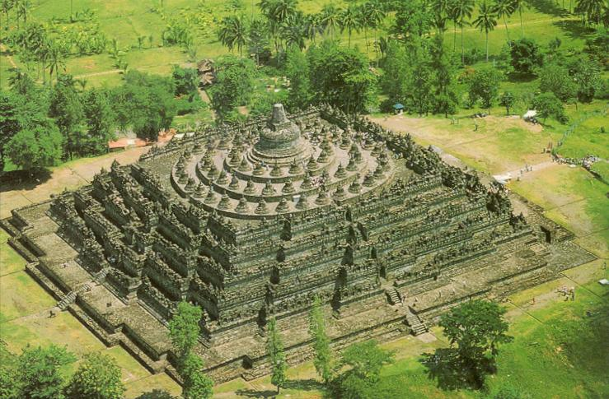
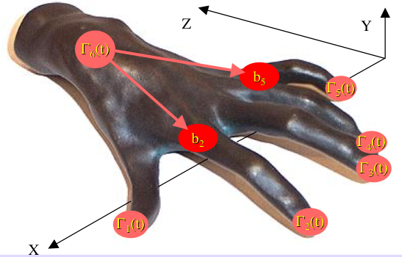
The Oniontology of Music
realities
communication
Facts
signs
Processes
Gestures

Slide 20
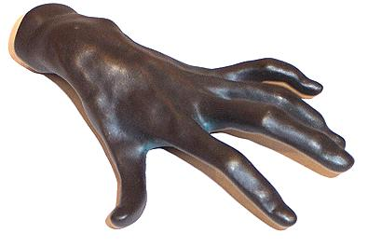
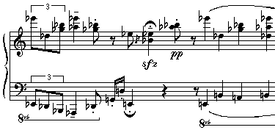
Embodiment
Gesture
to make
MIDI
Process
to refer to
Facts
to be the case

Slide 21
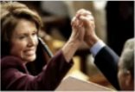
Embodiment
Gesture
Process
Facts

Slide 22
Embodiment
Gesture
disembodiment & schematization
Process
evaluation & dissection
Facts

Slide 23
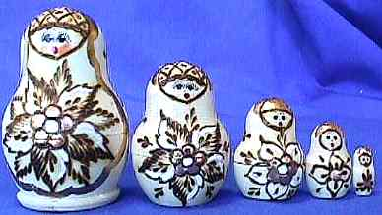
Louis Hjelmslev‘s Babuschka-Principle
Sign systems are boxed systems,
having components, which
are composed of sign subsystems,
which are again composed of
sign subsystems, etc.

Slide 24
Expression
Signification
Content
„Firework“
Connotation
Expression
Signification
Content
„Firework“
Firework

Slide 25
Poiesis:
Interpreter
Neutral Niveau:
Recording (e.g. CD)
Aesthesis:
Listener

Slide 26
Renate Wieland & Jürgen Uhde: Forschendes Üben
Die Klangberührung ist das Ziel der zusammenfassenden Geste, der Anschlag ist sozusagen die Geste in der Geste.
The sound contact is the target of the embracing gesture, the touch is so to speak the gesture within the gesture.
pitch
tip space
onset
position

Slide 27
Embodiment
describe and understand the category of the making!
Gesture
to make
MIDI
Process
to refer to
Facts
to be the case

Slide 28
Hugues de Saint-Victor (French theologist XIIth Century):
Gestus est motus et figuratio membrorum corporis, ad omnem agendi et habendi modum.
Gesture is the movement and figuration of the body‘s limbs proper to the achievement of all action and attitude.
skeleton
body
z
digraph Δ (topological) space X
g
X
Δ
x
y

Slide 29
Renate Wieland & Jürgen Uhde: Forschendes Üben
Die Klangberührung ist das Ziel der zusammenfassenden Geste, der Anschlag ist sozusagen die Geste in der Geste.
The sound contact is the target of the embracing gesture, the touch is so to speak the gesture within the gesture.
pitch
tip space
real forms?
onset
position

Slide 30
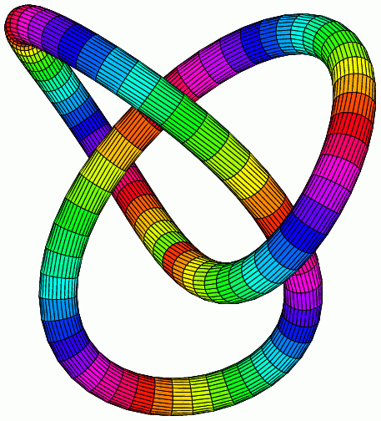
Answer: Hypergestures!
„loop of loops “
knot
loop

Slide 31
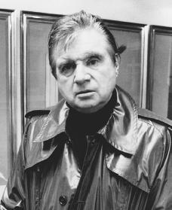
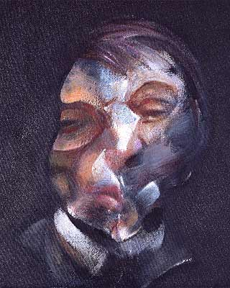
Francis Bacon
The marks are made, and you survey the thing like you would a sort of graph. And you see within this graph the possibilities of all types of fact being planted.. D. Sylvester: Interview with Francis Bacon: The Brutality of Fact. Thames and Hudson, New York 1975

Slide 32
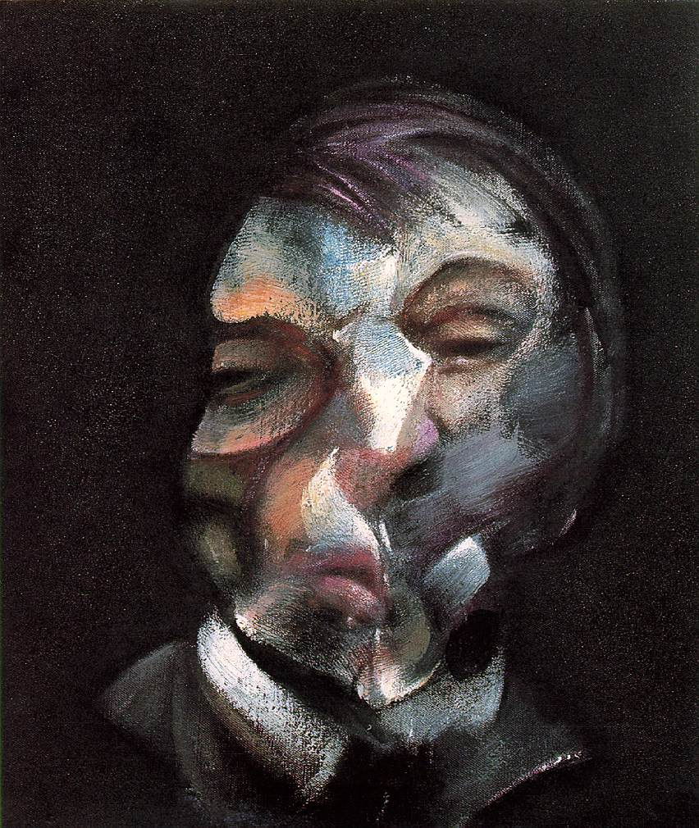
Francis Bacon (relating to the diagram debate): In the way I work I don’t in fact know very often what the paint will do, and it does many things which are very much better than I could make it do. Is that an accident?
... What has never yet been analysed is why this particular way of painting is more poignant than illustration. I suppose because it has a life completely of its own. (...) So the artist may be able to open up or rather, should I say, unlock the valves of feeling.

Slide 33
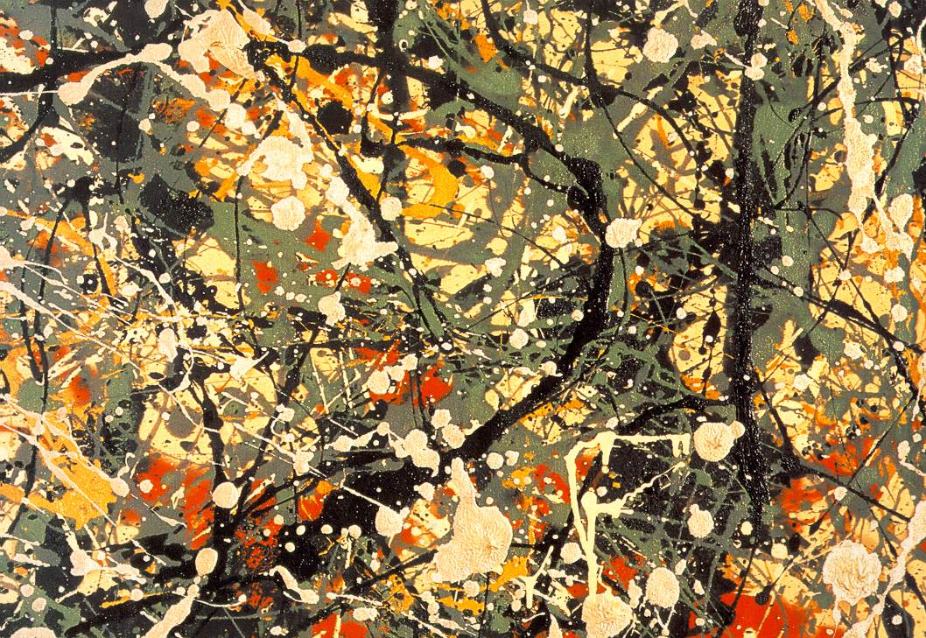
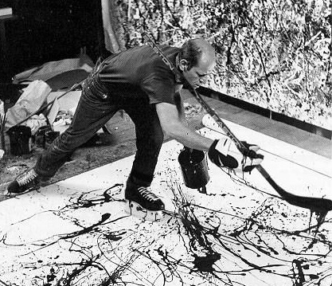
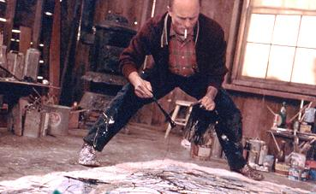
Jackson Pollock

Slide 34
Francis Bacon‘s flow = directed graph & distributed identity
→ collective ideation

Slide 35
How is communication achieved by such a graph?
?
gestures!

Slide 36
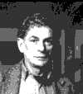
Jean Cavaillès (1903 - 1944): Comprendre est attraper le geste et pouvoir continuer.
Understanding is catching the gesture and being capable of continuing.
French Gesture Theory Paul Valéry (1871-1945)
Cahiers
Maurice Merleau-Ponty (1908-1961) Phénoménologie de la perception
André Leroi-Gourhan (1911-1986) Le geste et la parole
Gilles Deleuze (1925 - 1995):
Francis Bacon. La logique de la sensation.
Editions de la Différence, Paris 1981 „graph“ → „diagramme“
Gilles Châtelet (1944 - 1999):
Un diagramme peut immobiliser un geste, le mettre au repos bien avant qu’il ne se blottise dans un signe, et c’est pourquoi les géomètres ou les cosmologistes contemporains aiment les diagrammes et leurs pouvoirs d’évocation préemptoire.
A diagram can immobilize a gesture, put it to rest long before it hides itself within a sign, and this is why the contemporary geometers or cosmologists love diagrams and their power of preemptive evocation.
Charles Alunni (1951 -): Ce n‘est pas la règle qui gouverne l‘action diagrammatique, mais l‘action qui fait émerger la règle.
It is not the rule that governs the diagrammatic action, but the action that causes the rule to emerge.

Slide 37
What is collaboration?
More than working together, doing the same thing. Soldiers do not collaborate while marching in the same direction!
Management, science (teamwork), sports know the word, all use it. Not new, but not clear either.

Slide 38
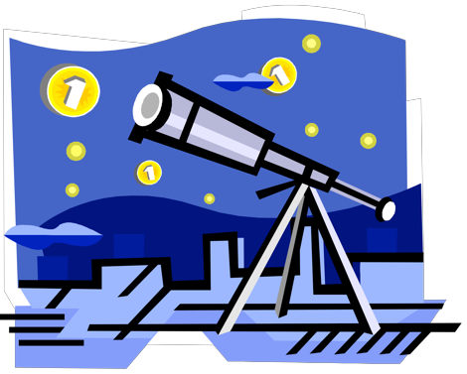
Collaboration is in particular important with regard to interdisciplinary projects and organizations. But it differs from interdisciplinarity!
It is in fact not possible to perform innovative interdisciplinary research without changing also the fundamentals of scientific behavior from individual and isolated working style to intense exchange of data, ideas, and engagements.
collaborative
interdisciplinary

Slide 39
Definition:
The art of collaboration is characterized by
the flow of a graphically distributed identity
by means gestural communication
within a collaborative space (collaboratory)

Slide 40
Computer scientist Bill Wulf defines (1989):
”A Collaboratory is a 'center without walls' in which the nation's researchers can perform their research
without regard to geographical location,
interacting with colleagues,
accessing instrumentation,
sharing data and computational resources,
and accessing information in digital libraries.”

Slide 41
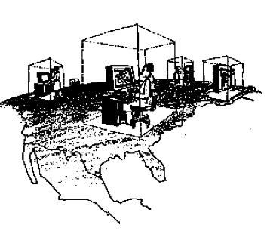
Richard T. Kouzes in a seminal paper on IEEE Computer (1996)
a virtual space!

Slide 42
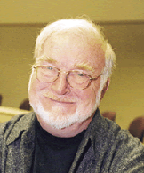
Flow (Mihaly Csikszentmihalyi) is being described as „being completely involved in an activity for its own sake. The ego falls away. Time flies. Every action, movement, and thought follows inevitably from the previous one, like playing jazz.“ Jazz improvisation as flow: „...the music will work itself“ „...goes into autopilot“ „...stream of consciousness“ B..J. Kenney M. Gellrich: Improvisation. In: R. Parncutt and G.E. McPherson (eds.) The science and psychology of musical performance. Creative Strategies for teaching and learning. New York: OUP 2002
chick-sent-me-high-ee
Jazz: Collaboration as a performing art R.A.R. MacDonald & G.B. Wilson: Construction of jazz: how jazz musicians present their collabortive musical practice. Musicae Scientiae X, Nr.1, Spring 2006

Slide 43
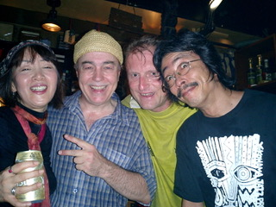
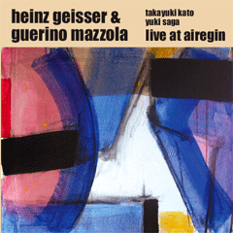
Flow in the Geisser-Mazzola-Kato-Saga quartet
Live at Airegin (Yokohama 2004), ayler records aylDL-056 Yuki Saga, voc. Takayuki Kato, egt. Guerino Mazzola, p. Heinz Geisser, perc.
Nu (now) 26:34

