Slide 1
III THE LANDSCAPE OF FREE JAZZ
III.2 (Thu Feb 15) Out of this world John Coltrane „Out of this World“ and „Om“

Slide 2
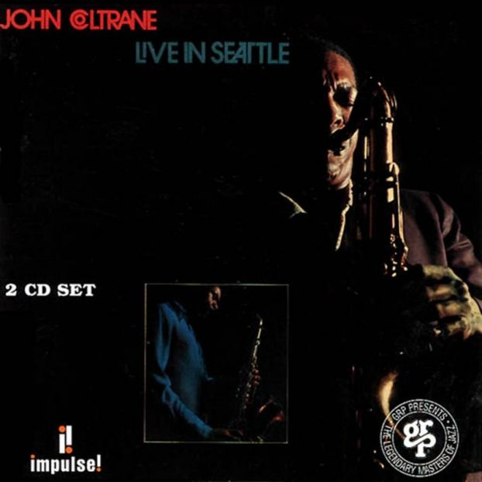
John Coltrane t & s saxophones
Pharoah Sanders tenor saxophone
McCoy Tyner piano
Donald R. Garrett bass
Jimmy Garrison bass
Elvin Jones drums
Recorded live at the Penthouse in Seattle, Washington on September 30, 1965
Cosmos 10:49 Out of this World 23:34 Evolution 36:22 Tapestry in Sound 06:07
Albert Ayler: John was like a visitor to this planet. He came in peace and he left in peace; but during his time here, he kept trying to reach new levels of awareness, of peace, of spirituality. That‘s why I regard the music he played as spiritual music—John‘s way of getting closer and closer to the Creator.
Sirone: There was only one time that I could say that any individual was the greatest, and this was with John.

Slide 3
Out of this World: „rubato ballad“ (Ekkehard Jost)
6/8 beat at M.M = 80 quarters p min.
0:00 J.C. E♭ minor melody —> 2:24 C minor
4:01 Ph.S. E♭ minor + descending gestures
8:21 M.T. E♭ minor slow 3 pulse (1/8-3/8-4/8-6/8 timed chords)
12:21 J.C. back on soprano
15:59 J.C. + Ph. S. duo around E♭
20:18 J.C. on tenor
22:11 M.T. concludes
Simultaneous presence of slow and very fast pulses:
multidimensionality in time shaping, vivisection of time

Slide 4
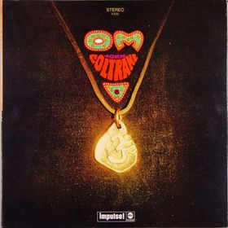
John Coltrane t & s saxophones
Pharoah Sanders tenor saxophone
McCoy Tyner piano
Joe Brazil flute
Donald R. Garrett bass, clarinette
Jimmy Garrison bass
Elvin Jones drums
Recorded at the recording studio Camelot in Seattle, Washington on October 1, 1965 (!!!)
Om 28:50
Nat Hentoff (liner notes): Trane: „Om means the first vibration—that sound, that spirit which set everything else into being. It is The Word from which all men and everything else comes, including all possible sounds that man can make vocally. It is the first syllable, the primal word, the word of Power.
Interestingly, among Tibeteans and northern Buddhists, there is a mystic formula, Om mani padme hum („Om, the jewel, is the lotus: amen.“) Those are the first words taught to a child and they are the last words spoken by a believer on his death bed. According to Brewer‘s Dictionary of Phrase and Fable, „The lotus symbolizes universal being, and the jewel the individuality of the utterer.“

Slide 5
Nat Hentoff (liner notes):
It may be that to break the circumscribed limits of conventional hearing, the ear must be propelled to hear sounds and pitches it has rejected in the past, just as compassion is not come by in conventional comfort. And once heard and absorbed, these sounds lead to further extensions of listening and feeling capacities.
In any case, the process cannot be forced. My own feeling, after this kind of listening experience, is like that of Ralph Gleason‘s when he reviewed a Coltrane performance in San Francisco a few months after this record was made: „It was one of the most exhilarating musical experiences I have ever had.“ He wrote of the „long, almost continuous presentation of improvisation,“ of „ensemble climaxes of stupendous intensity.“
But there are others who may find difficulty discovering a personal center of gravity in Om. In so far as one can ever advise anyone else in how to listen, I would suggest that they start by not worrying about how it is all structured, where it‘s leading. Let the music come in without any pre-set definitions of what jazz has to be, of what music has to be.

Slide 6
Stacia Proefrock, All Music Guide
Condemned by many critics as John Coltrane's worst album, Om suffers only in comparison to the great works that preceded it. Also issued in 1965, Ascension had stunned the jazz world with the blunt force of its innovation—a swirling maelstrom of noise, it was an answer to the challenge that had been posed by Ornette Coleman's Free Jazz several years earlier. For all the sonic assault that Pharoah Sanders and Coltrane mustered up on Ascension, however, it contained some surprisingly clear solos and had the feel of a well-thought-out interplay between all of the musicians on the date, including classic quartet members Elvin Jones, Jimmy Garrison, and McCoy Tyner.
Om, in contrast, seems more like a pure release of energy. Expressions of sanity and organization by the rhythm section seem detached from the wall of sound that Sanders and Coltrane have erected. The best moments come when Coltrane breaks away from Sanders for solos—echoes of Love Supreme can be heard in the repetitive, circular themes.
Regardless of its seeming chaos, this is a deeply spiritual work, and can be seen as a darker, more unhinged version of the invocations heard on that album. Indeed, Om resonates with passion and yearning, but has a frantic edge that suggests that opening up to all of that powerful spiritual energy might have been a frightening experience. The music isn't perfect, as the thematic flow sometimes seems a bit segmented, and talented members of the band are relegated a little too far to the background (like McCoy Tyner, who nevertheless has a beautiful short solo around 13:30).
Regardless, Om doesn't deserve the dismissal it has been given by critics. It is an important work in the history of free jazz that opens up considerably by the end of its 29 minutes, revealing the expansive contents of a jazz master's mind.

Slide 7
0:00 ritual om song
1:20 collective
3:06 J.C. solo: b♭-a♭-f (retrograde of A Love Supreme cell), b♭ pedal tone
7:27 tutti, Ph.S. long tones, descending gestures, not pitches, overtones heard?
9:59 om-om singing (J.C.+Ph.S. ?)
11:00 M.T. solo, lots of A Love Supreme cells (ascending), zig-zag e-f-a♭-b♭-a♭-a♭-f-e
15:00 jungle sounds, bass, flute, „animal voices“ (bass clarinette?)
17:20 M.T. in, lots of percussion
19:14 J.C. back
19:55 bass solo
20:12 Ph.S. + R.G. melody back
21:20 J.C. + Ph.S. duo later with J.B.
22:40 fast repetitions of J.C. = the real meter!
23:10 duo J.C. + Ph.S. alternating roles
around 24:00-25:30 climax
27:10 reprise of ritual om song

