Slide 1
III THE LANDSCAPE OF FREE JAZZ
III.1(Tue Feb 13) Out of this world Sun Ra „A Joyful Noise“ (DVD 1980)

Slide 2
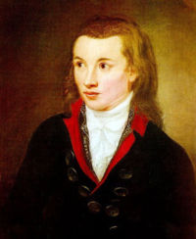
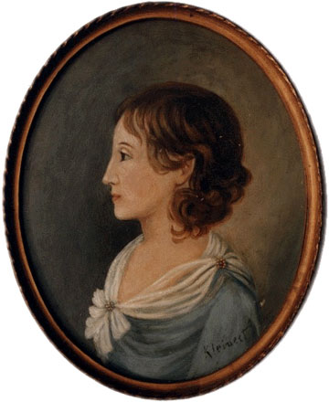
Novalis (Freiherr von Hardenberg) May 2, 1772 - March 25, 1801
Most important German romantic writer and philosopher
Novel „Heinrich von Ofterdingen“:
The search for the „blue flower“
Where do we go? Always home.
Every enjoyment is musical, hence mathematical.
romantic =
belief in infinity
Sophie von Kühn

Slide 3
Parallel to the cultural reorientation back to the roots, which is taken in order to reset the cultural basis of the Great Black Music against the white man's usurpation, we encounter also a strong hyperromantic movement "Out of This World" (a Harold Arlen title in John Coltrane's recordings).
We have already seen such a movement in Coltrane‘s „A Love Supreme“. We shall come back to Coltrane later.
Sun Ra might be the most extremal, but also the most controversial constructor and actor of such far-out references. His claim of being cosmic and intergalactic of provenance is more an artistic subterfuge than a religious avowal, but no precise information is available...

Slide 4
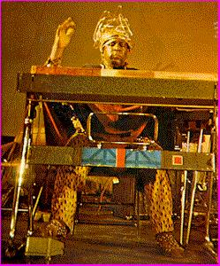
Sun Ra (Herman Sonny Blount)
Birmingham, Alabama 1914 (?) -1993.
Worked with Fletcher Henderson, Coleman Hawkins et al.
To Chicago 1946-61, new name ‚Le Sony‘r Ra‘.
Founded the Arkestra big band with
John Gilmore, Pat Patrick, et al. also dancers and fire-eaters.
Had commune of musicians, infinite rehearsals.
1956 first LP „Sun Song“
After gig in Montreal Sun Ra moved to NYC.
„I‘m actually painting pictures of infinity with my music, and that‘s why a lot of people can‘t understand it. And when I say so, a lot of people don‘t believe me. But if they‘d listen to this and to other types of music, they‘ll find that this has something else in it, something from another world.“

Slide 5
sun ra
A Film by Robert Mugge

