Slide 1
V Gesture Theory of Musical Time Construction
(Mo Feb 19)

Slide 2
V.1 Theories of Musical Time Constructions
The Fundamental Situation
Paul Valéry
Nathan Kramer

Slide 3
V.1.1 Fundamentals

Slide 4
A. The Performer’s Space-Time
There is a serious discrepancy between the artistic concept of the performer’s presence and the scientific description of presence in terms of physical space-time:
The latter only allows for an infinitesimally short spot on the time axis!
PRESENCE
time

Slide 5
A Solution: Stephen Hawking’s Complex Space-Time
The physicists Stephen Hawking and Itzak Bars have proposed to add a second dimension to time to solve fundamental problems of modern astrophysics relating to the Cosmic Big Bang
imaginary time
space
PRESENCE
real time

Slide 6
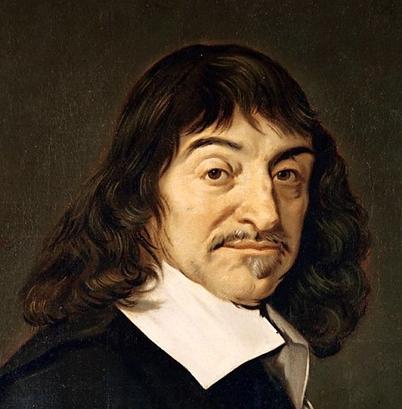
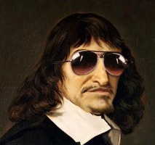
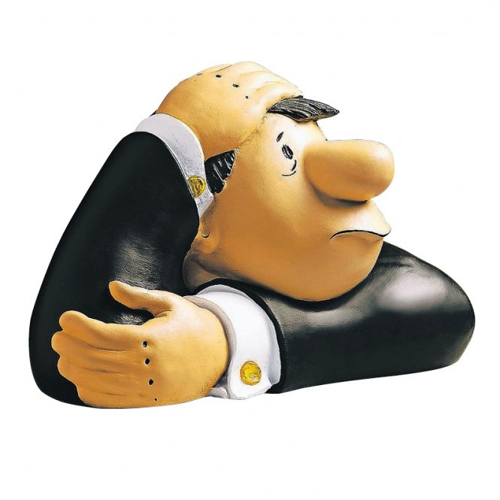
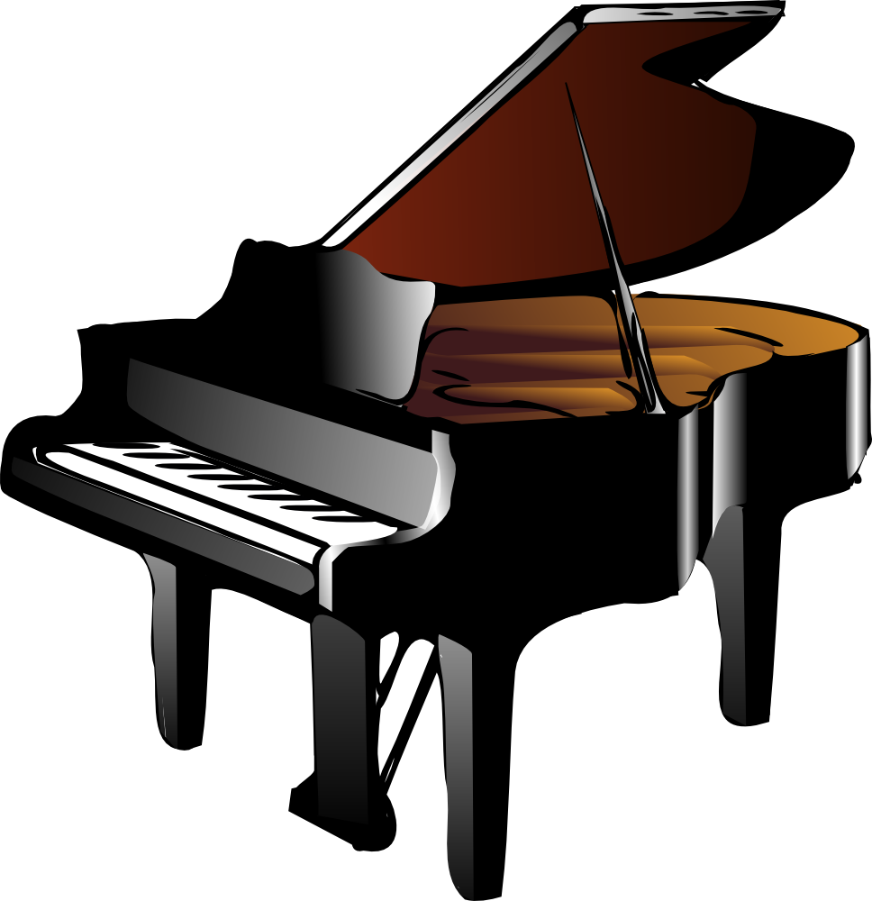
imaginary time i.—
René Descartes
res cogitans ~ —³ ⊕ i. —
real time —
res extensa ~ —³ ⊕ —
space —³

Slide 7
In aincient Greek philosophy, there were two concepts of time:
1. chronos, the linear time that is controlling our trajectory
in this world‘s reality
2. kairos, the time of human presence.

Slide 8
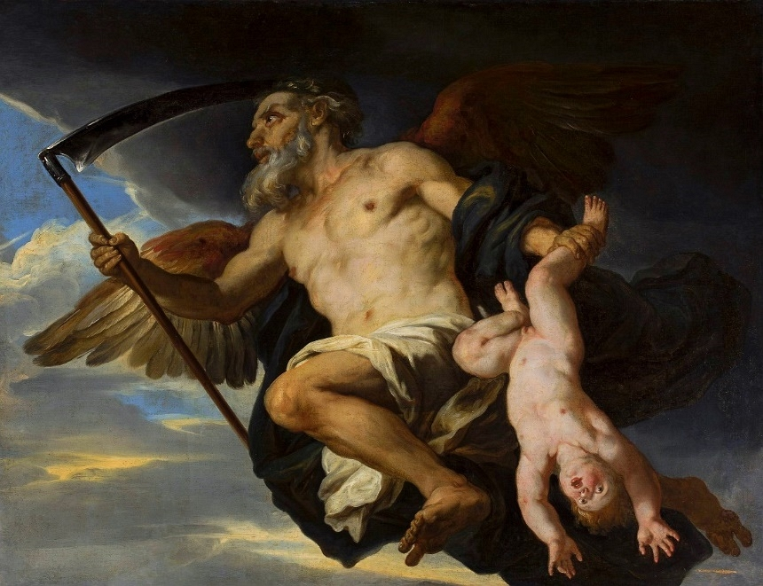
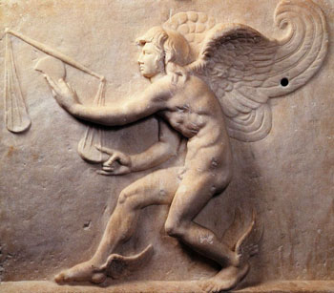
1. chronos, the linear time that is controling our trajectory
in this world‘s reality, humans are passive in this reality.
2. kairos, the time of human presence, a gestural concept.
chronos
kairos

Slide 9
What does happen in the preforming artist’s imaginary space-time?
why?
retrieve
plan
flow of
structures

Slide 10
interface of bodies
sound
interface =
the instrument
musician
what?

Slide 11
space of gestures
make
catch
how?

Slide 12
Performer’s Imaginary Space-Time: Action: The balanced dancing presence
Agent: Beautifully determined responsibility
interface of bodies
why?
space of gestures
sound
RESPONSIBILITY:
knowing why what
make
retrieve
The performer in his beautifully determined responsibility, displays a balanced dancing presence
DANCE
PRESENCE
DETERMINATION:
knowing how why
BEAUTY:
knowing how what
BALANCE
catch
how?
plan
musician
flow of
structures
what?

Slide 13
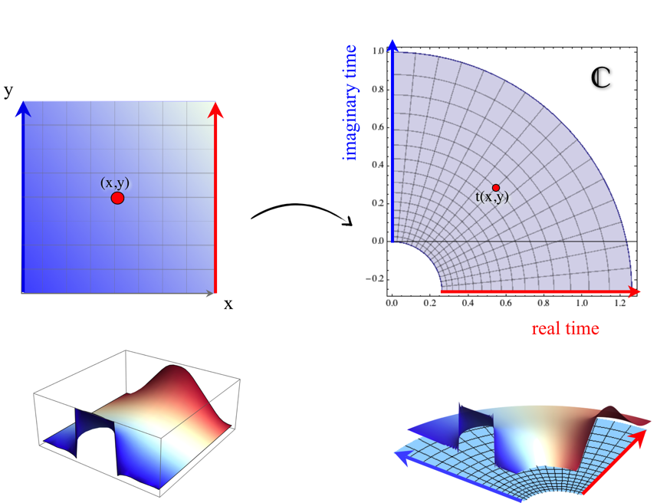
B. Moving Through Complex Time
Setting up the complex time surface for a movement from imaginary (symbolic) score time to real (physical) performance time

Slide 14
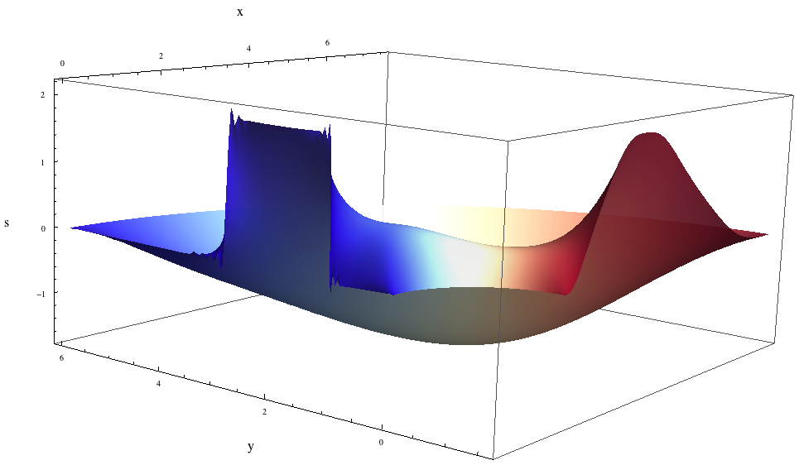
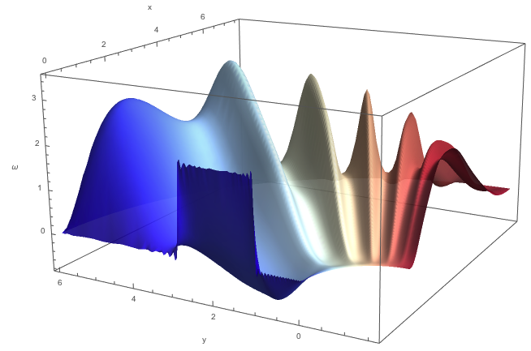
Filling out the world sheet between symbolic (score) and physical (performance) movements
by minimizing the Lagrange function S = V – U, V = kinetic energy, U = potential energy
simple U potential
The problem here
is that the
performance curve (red)
is to be determined:
this is the performance task.
complicated U potential

Slide 15
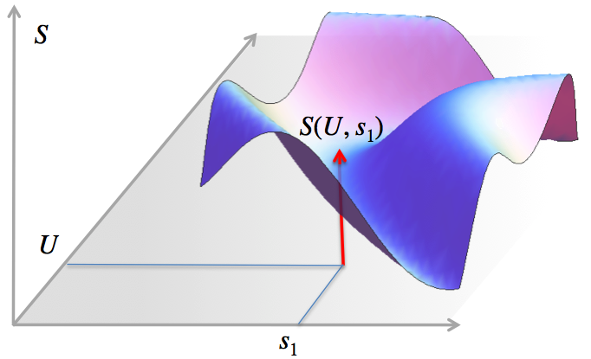
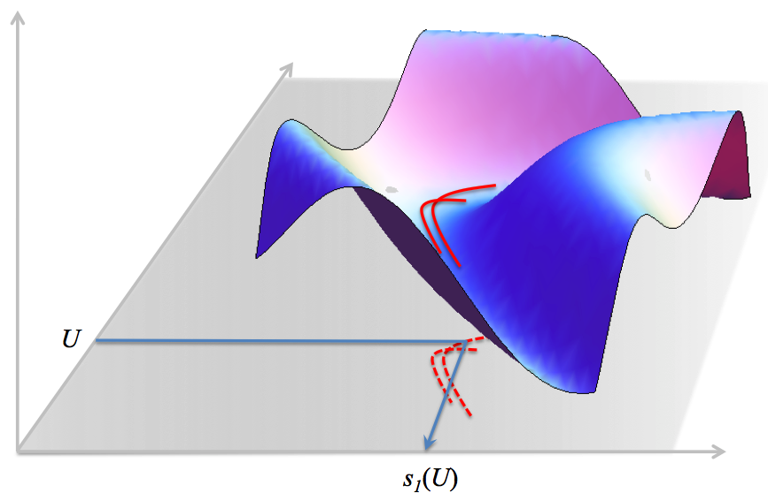
We have this connection between potential U, performance curve s₁, and Lagrange function S
performance as function of
Potential U

Slide 16
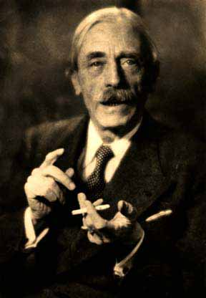
V.1.2 Paul Valéry, Especially Dance Theory
It is not surprising that Valéry wrote an essay on the philosophy of dance, in which he concludes not with a scholarly description of dance, but by suggesting we start dancing our thoughts instead of thinking about dance.

Slide 17
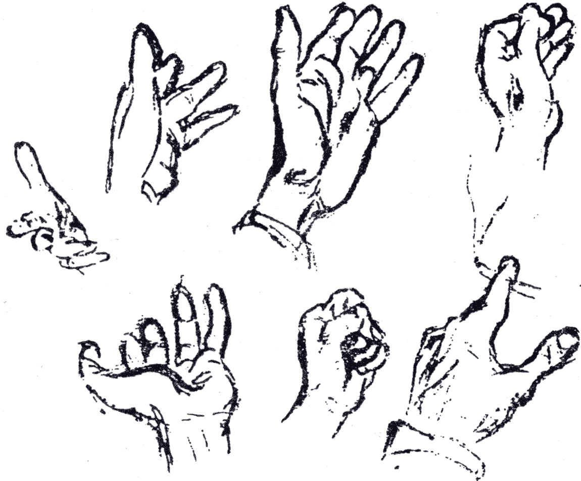
DANS CES MURS VOUÉS AUX MERVEILLES
J’ACCUEILLE ET GARDE LES OUVRAGES
DE LA MAIN PRODIGIEUSE DE L’ARTISTE
ÉGALE ET RIVALE DE SA PENSÉE
L’UNE N’EST RIEN SANS L’AUTRE
(Paul Valéry, Palais Chaillot)
Paul Valéry (1871-1945)
IN THESE WALLS DEVOTED TO THE MARVELS I RECEIVE AND KEEP THE WORKS
OF THE PRODIGIOUS HAND OF THE ARTIST
EQUAL AND RIVAL OF HIS THOUGHT
ONE IS NOTHING WITHOUT THE OTHER
C'est l'execution du poème qui est le poème. It’s the rendition of a poem which is the poem.
The interest of science lies in the art of doing science.

Slide 18
Palais Chaillot:
Dans ces murs voués aux merveilles J’accueille et garde les ouvrages De la main prodigieuse de l’artiste égale et rivale de sa pensée L’une n’est rien sans l’autre.
(In these walls devoted to the marvels I receive and keep the works of the artist’s prodigious hand equal and rival of his thought one is nothing without the other.)

Slide 19
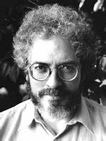
V.1.3 Jonathan Kramer, Especially his Gestural and Vertical Times
In Jonathan D. Kramer’s impressive account on time in music [72], we are given a rich spectrum of different time concepts. Kramer however stresses that he does not present strict definitions, he states:
“ Time must ultimately be taken as undefinable.”
He then concludes :
“They (the categories of time) are more suggestions for listening than rigorous theoretical formulations.” Nevertheless, Kramer proposes quite precise conceptualizations.

Slide 20
Before we delve into Kramer’s time categories, it is important to understand how he positions musical time as an ontological locus. He write:
“In the following chapters I postulate many types of musical time. To do so becomes possible once I accept the notion that music creates time. (...) Time it- self can (be made) move, or refuse to move, in more than one ‘direction’: not an objective time out there, beyond ourselves, but the very personal time created within us as we listen deeply to music.”
This constructivist position is essential in our approach, too. Kramer distinguishes “ordinary” physical time from its musical counterpart:
“The difference between ordinary lived time and musical time is, according to Clifton, the difference «between the time a piece takes and the time which a piece presents or evokes.» (...) All the species of time discussed in this book are experienced and understood simultaneously with ordinary time.”

Slide 21
Kramer proposes four categories of time: Multiply-directed, gestural, moment, and vertical. Here are the definitions in his glossary:
gestural time: species of multiply-directed musical time in which the conventional meaning of gestures (beginnings, endings, structural upbeats, etc.), rather than the literal successions of events, determine the logic of continuity.
moment time: temporal continuum of a moment-form composition
multiply-directed (linear) time: temporal continuum in which progression is seemingly in several directions at once
vertical time: temporal continuum of the unchanging, in which there are no separate events and in which everything seems part of an eternal present.

Slide 22
Vertical time is the musical time par excellence, very difficult to conceive, but it is the type of time we want to interpret in mathematical gesture theory. Let us give some references to Kramer’s conceptual sketches. Two citations seem central.
First:
“But some new works show that phrase structure is not a necessary component of music. The result is a single present stretched out into an enormous duration, a potentially infinite ‘now’ that nonetheless feels like an instant. In music without phrases, without temporal articulation, with total consistency, whatever structure is in the music exists between simultaneous layers of sound, not between successive gestures. Thus, I call the time sense invoked by such music vertical.”

Slide 23
The second citation describes the way one listens to vertical music:
“Listening to a vertical musical composition can be like looking at a piece of sculpture. When we view the sculpture, we determine for ourselves the pacing of our experience: We are free to walk around the piece, view it from many angles, back and view the whole, contemplate the relationship between the piece and the space in which we see it, close our eyes and remember, leave the room when we wish, and return for further viewings.”

Slide 24
Example 1: Bill Evans „Autumn Leaves“
Example 2: John Coltrane „Ascension“

Slide 25
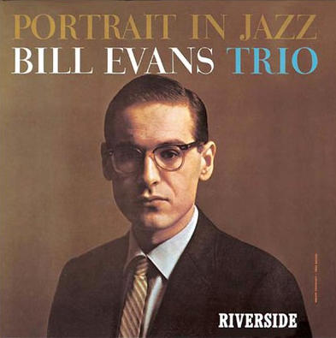
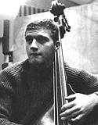
Bill Evans p
Scott LaFaro b
Paul Motian ds
Joseph Kosma‘s
Autumn Leaves 5:59
Riverside Dec 28 1959, NYC
1929-1980

Slide 26
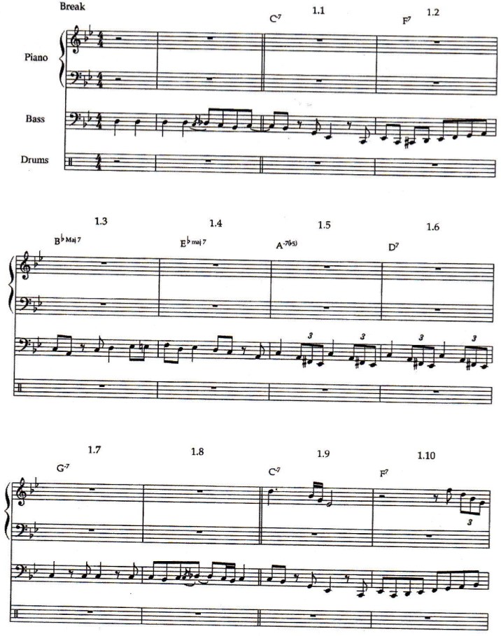
Robert Hodson:
Interaction, Improvisation, and Interplay in Jazz Routledge NY 2007

Slide 27
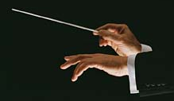
topological deformation of motives →
similar shapes →
gestural utterances
Rudolph Reti, Chantal Buteau: math. theory of motives

Slide 28
Bill Evans (line notes):
„I‘m hoping the trio will grow in the direction of simultaneous improvisation rather than just one guy blowing followed by another guy blowing. If the bass player, for example, hears an idea that he wants to answer, why should he just keep playing a background?“
Processes of motivic and gestural
imitation,
transformation,
contrast, and
resonance
45‘‘
str110%
ptch 2.5

Slide 29
contrast 1
imitation 1
imitation 2 (b-flat/g)
resonance 1 (d/e-flat)
imitation 3
imitation 4
contrast 2
imitation 5 (of ds!)
imitation 6

Slide 30
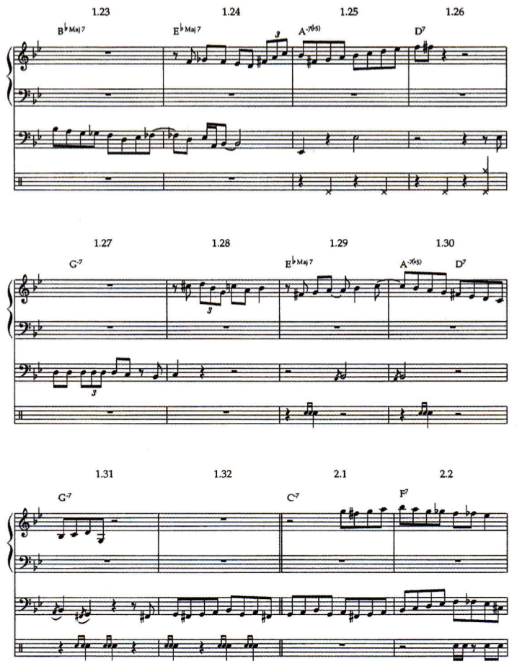
imitation 7
imitation 8
resonance 2
resonance 3

Slide 31
Robert Hodson:
Interaction, Improvisation, and Interplay in Jazz Routledge NY 2007
45‘‘
str110%
ptch 2.5

Slide 32
contrast 1
imitation 1
imitation 2 (b-flat/g)
resonance 1 (d/e-flat)
imitation 3
imitation 4
contrast 2
imitation 5 (of ds!)
imitation 6

Slide 33
imitation 7
imitation 8
resonance 2
resonance 3

Slide 34
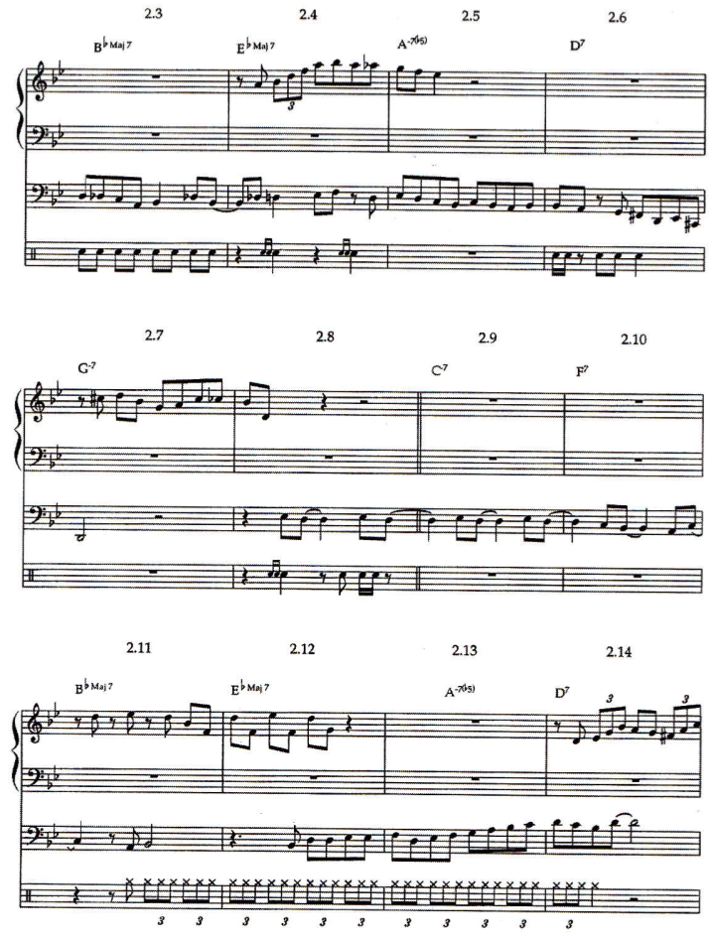

Slide 35
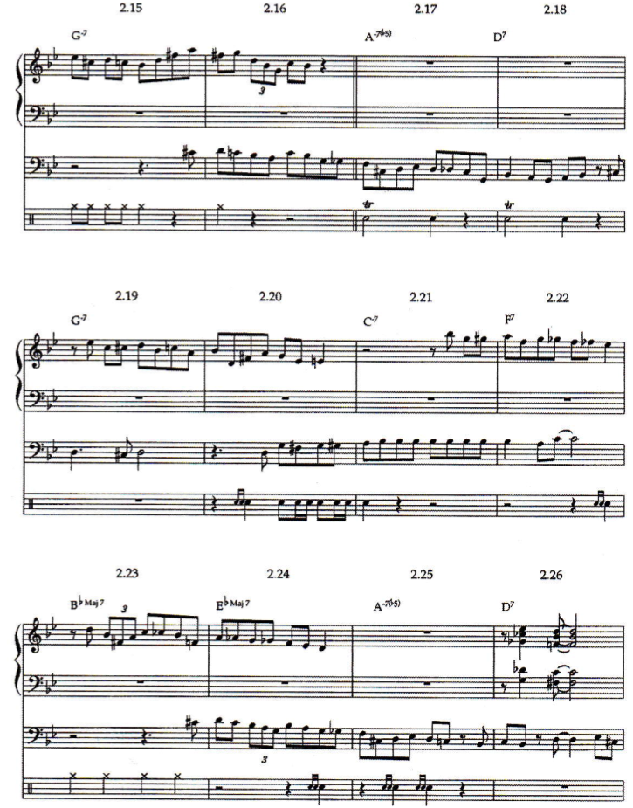

Slide 36
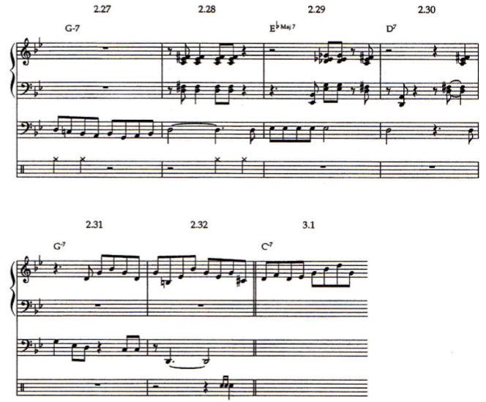

Slide 37
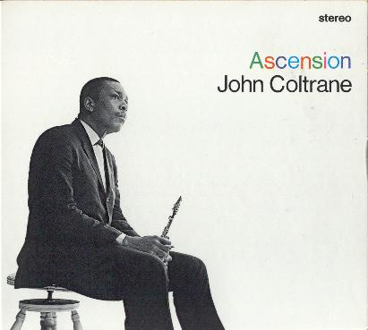
John Coltrane ts
Pharoah Sanders ts Archie Shepp ts Marion Brown as
John Tchicai as
Freddie Hubbard tp Dewey Johnson tp McCoy Tyner p Art Davis b
Jimmy Garrison b
Elvin Jones d
recorded at the Van Gelder Studio, Englewood Cliffs, NJ June 28, 1965
Ascension Edition II 40:32 (Ascension Edition I 38:37)
From liner notes: To begin at the beginning, a caveat for the casual listener. Be advised that this record cannot be loved or understood in one sitting, and that there can be no appreciation at all in two minutes listening to an arbitrary excerpt in a record store. (...) Marion Brown described the session as „wildly exciting. We did two takes, and they both had that kind of thing in them that makes people scream. The people who were in the studio were screaming.

Slide 38
0:00 „modal spectrum“ 3:10
3:10 Coltrane 2:40
5:50 „modal spectrum“ 2:00
7:50 Johnson 1:46
9:34 „modal spectrum“ 2:22
11:56 Sanders 3:32
14:28 „modal spectrum“ 1:13
15:41 Hubbard 2:02
17:43 „modal spectrum“ 1.11
18:54 Brown 1:07
20:03 „modal spectrum“ 1:14
21:17 Shepp 2:59
24:16 „modal spectrum“ 1:00
25:16 Tchicai 2:06
27:22 „modal spectrum“ 2:37
29:59 Tyner 3:29
33:28 basses 2:28
35:56 „modal spectrum“ 4:36
40:32 end total: 22:09 18:23
hounted

Slide 39
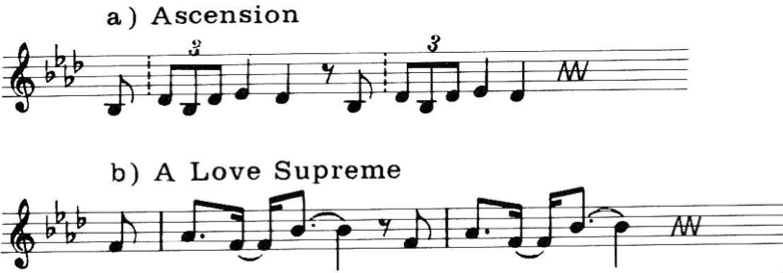
modal spectrum: B_{flat}maj triad „arpeggiated by modes“
11
0
1
11
0
1
11
0
1
11
0
1
10
2
10
2
10
2
10
2
9
3
9
3
9
3
9
3
8
4
8
4
8
4
8
4
7
6
5
7
6
5
7
6
5
7
6
5
B_{flat} aeolian
D_{flat} scale
D phrygian
B_{flat} scale
F phrygian
D_{flat} scale
B_{flat} aeolian
D_{flat} scale

Slide 40
Closed Spaces — Open Spaces
Closed Spaces
populate given spaces such as
tonalities/cadences/modulation
consonances/dissonances
32 song/ blues scheme
sonata scheme...global forms
conductor‘s baton
a-1, a-2, a-1, 2, 3, 4...
etc.
Open Spaces
transcend given spaces (Sirone: „one octave higher“) via
variation of spaces (e.g. scale/chord types: ToM lists, example: chromatic chord {c, c#, d} with 23 (!) 3rd ext.)
extending spaces (Folia #3: beginning)
negation of the space limits (Monk: C/D)
suspending structures/rules (Evans: dialog)
exchanging roles of parameters (tuning...)
creating empty spaces (#7 CD: 5:26)
etc.
Collaborative principle for open space creation/negotiation:
Be constantly aware of the musicians‘ positions in those spaces in order to enable them to unfold with a maximal relief and collaborative presence.

Slide 41
ionian, dorian, phrygian, lydian, mixolydian, aeolian, locrian
chords of modal spectra

Slide 42
Coltrane
Brown
Tyner
B_{flat}maj modal triad
Hubbard
Sanders
Tchicai
Shepp
Johnson

