Slide 1
VI Gestures in Performance and the Performative Construction of Vertical Time
(Fr Feb 23)

Slide 2
VI.1 The Ontological Transformation in Performance

Slide 3
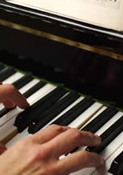
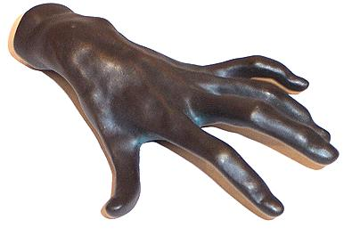
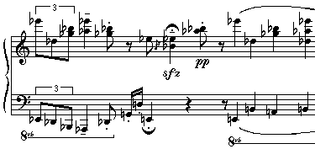
gestures
sound events
h
instrumentalize
e
l
gestural
embodiment
instrumental- interface
„thaw“
℘
physical
reality
score
symbolic
reality
Notes:
More precisely, performance is a transformation P from the symbolic reality of the score to the physical reality of sounds (a quarter note is not determined in its physical duration, only the metronome yields the relation between symbolic reality and physical reality).
The mathematical analysis of tempo and pitch transformations shows that the performance transformation P can be described by a performance vector field, as shown to the left in the symbolic parameter space.
Essentially, performance is calculated via integration of such performance vector fields, much as the time is calculated via integration of the tempo curve.
In this language, performance operators are built in order to produce new performance fields from the old ones inherited from the relative mothers.

Slide 4
VI.2 Performance of Score-defined Music

Slide 5
sound events
gestures
h
instrumentalize
e
l
gestural
embodiment
instrumental- interface
℘
„thaw“:
1. analyze score content
harmonically,
rhythmically,
and melodically.
2. Conceive a gestural
interpretation of your
analysis
score
3. Check from the acoustical
output whether the
gesturalization
corresponds to your
analysis.
Notes:
More precisely, performance is a transformation P from the symbolic reality of the score to the physical reality of sounds (a quarter note is not determined in its physical duration, only the metronome yields the relation between symbolic reality and physical reality).
The mathematical analysis of tempo and pitch transformations shows that the performance transformation P can be described by a performance vector field, as shown to the left in the symbolic parameter space.
Essentially, performance is calculated via integration of such performance vector fields, much as the time is calculated via integration of the tempo curve.
In this language, performance operators are built in order to produce new performance fields from the old ones inherited from the relative mothers.

Slide 6
VI.4 A Mathematical Model of Musical Time Construction via Gestural Diagrams
In the following discussion, we develop a mathematical construction of vertical time that is based on diagrams of gestures.
This approach is inspired by the construction of a distributed identity in the collaborative musicianship described above for creative interaction in improvised music, especially jazz group improisation.

Slide 7
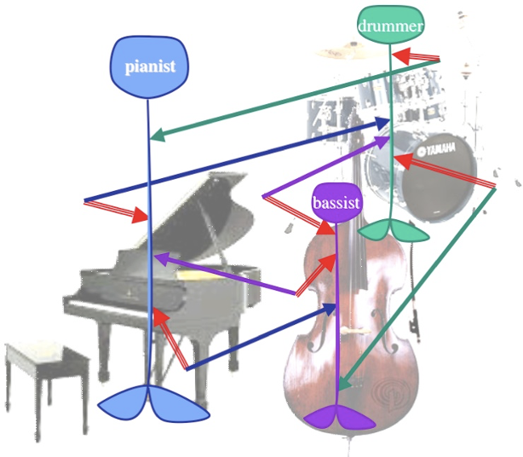
VI.4.0 The Distributed Identity and Time Construction in Improvisation
Activity finds itself turned into passivity, subjected to the superior external force of a distributed identity. One could suspect that this is a paralyzing effect, but all free jazz musicians who know about that effect agree that this dialectic is the most securing effect to demonstrate that both collective ideation and the product of flow have now been achieved. There is a word for such a moment, and the word is passion. Passion is an extremely active attitude, but also one that lets you rotate under the dominance of an external force, around a higher axis and lets you feel strong in this synthesis of the wild making and the rotational stability of the gyroscope.

Slide 8
VI.4.1 Modeling the Distributed Identity by Gestural Diagrams

Slide 9
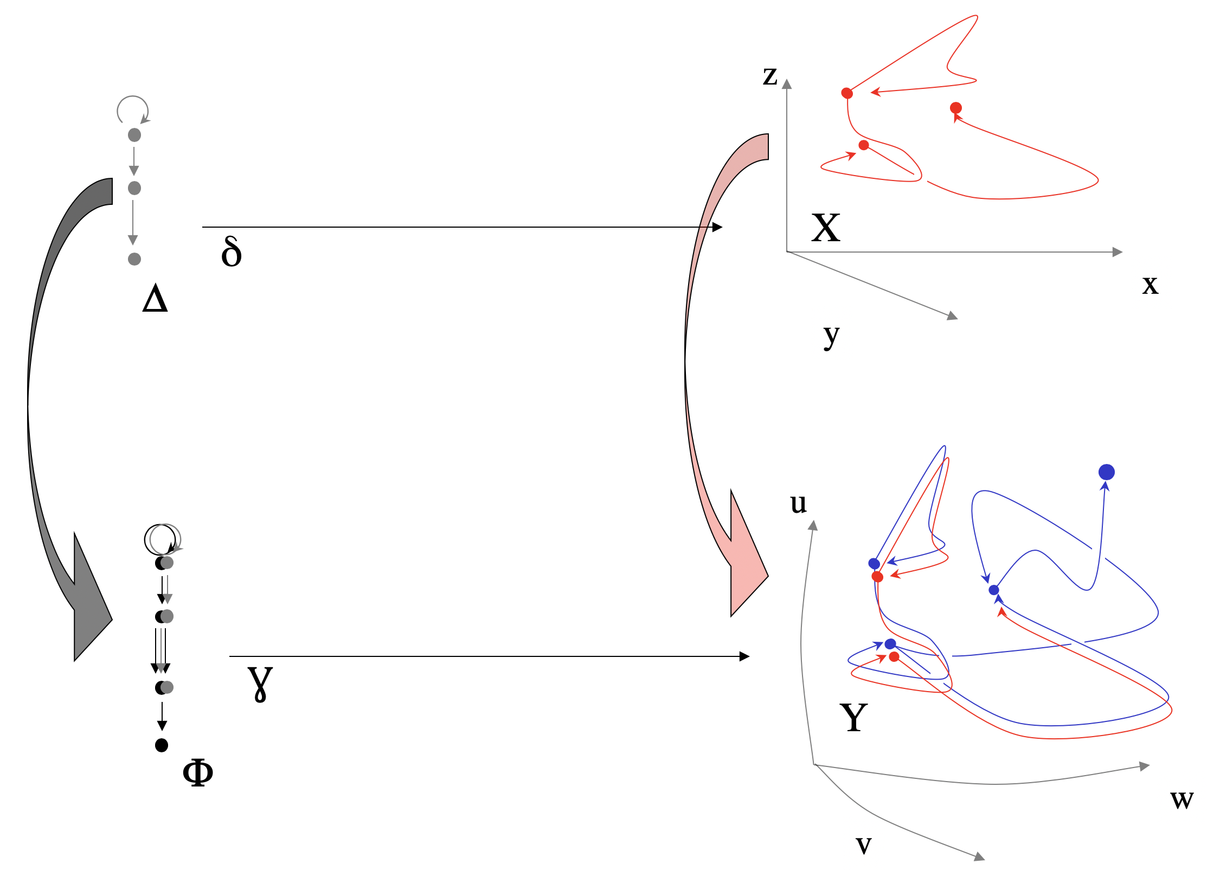
Morphisms of gestures

Slide 10
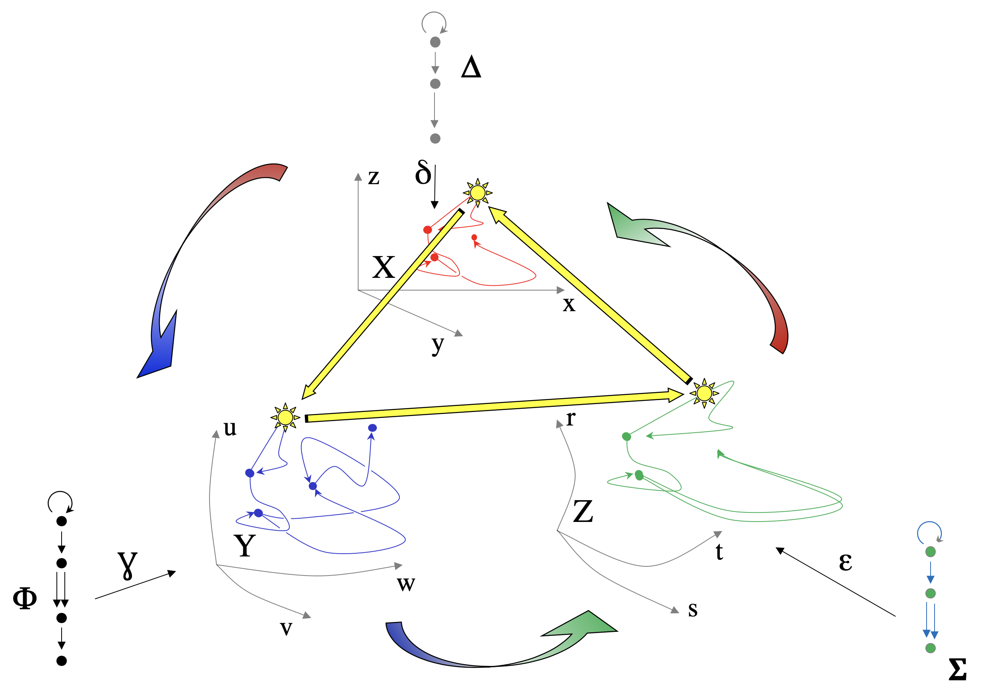
The projective limit of a gesture diagram

Slide 11
VI.4.2 Calculating the Projective Limit of a Gestural Diagram

Slide 12
VI.4.3 The Projective Limit of a Gestural Diagram
A gestural diagram is a diagram D of gestures, i.e. a set of gestures D_{i}: 𝚫_{i} —> X_{i} together with gesture morphisms
f_{ijk}: D_{i} —> D_{j} , i.e. commutative diagrams
→
D_{i}
D_{j}
→
𝚫_{i} —> X_{i}
t_{ijk} g_{ijk}
𝚫_{j} —> X_{j}
|𝚫_{i}| —> X_{i}
t_{ijk} g_{ijk}
|𝚫_{j}| —> X_{j}
which is equivalent
to the natural gesture
morphisms of topolo-
gical spaces
→
→

Slide 13
VI.4.4 The Projective Limit of a Gestural Diagram
The limit of this diagram of natural gestures is defined as follows:
First consider all the morphisms
|𝚫_{i}|
t_{ijk}
|𝚫_{j}|
X_{i}
g_{ijk}
X_{j}
Then we take the subset Lim₁ of ∏ _{i} |𝚫_{i}|
consisting of the sequences (d_{i}) such that
t_{ijk}(d_{i})=d_{j}
and the subset Lim₂ of ∏ _{i} X_{i} consisting
of the sequences (x_{i}) such that
g_{ijk}(x_{i})=x_{j}
We then have an evident map
Lim(D): Lim₁ —> Lim₂

Slide 14
d_{i}
|𝚫_{i}|
t_{ijk}
|𝚫_{j}|
|𝚫_{i}|
t_{ijk}
d_{i}
t_{ijk}
d_{j}
|𝚫_{j}|
d_{j}

Slide 15
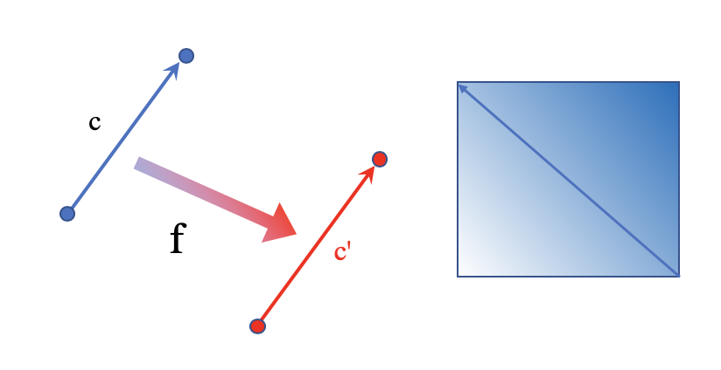
VI.4.5 Examples
Example 1

Slide 16
Example 2

Slide 17
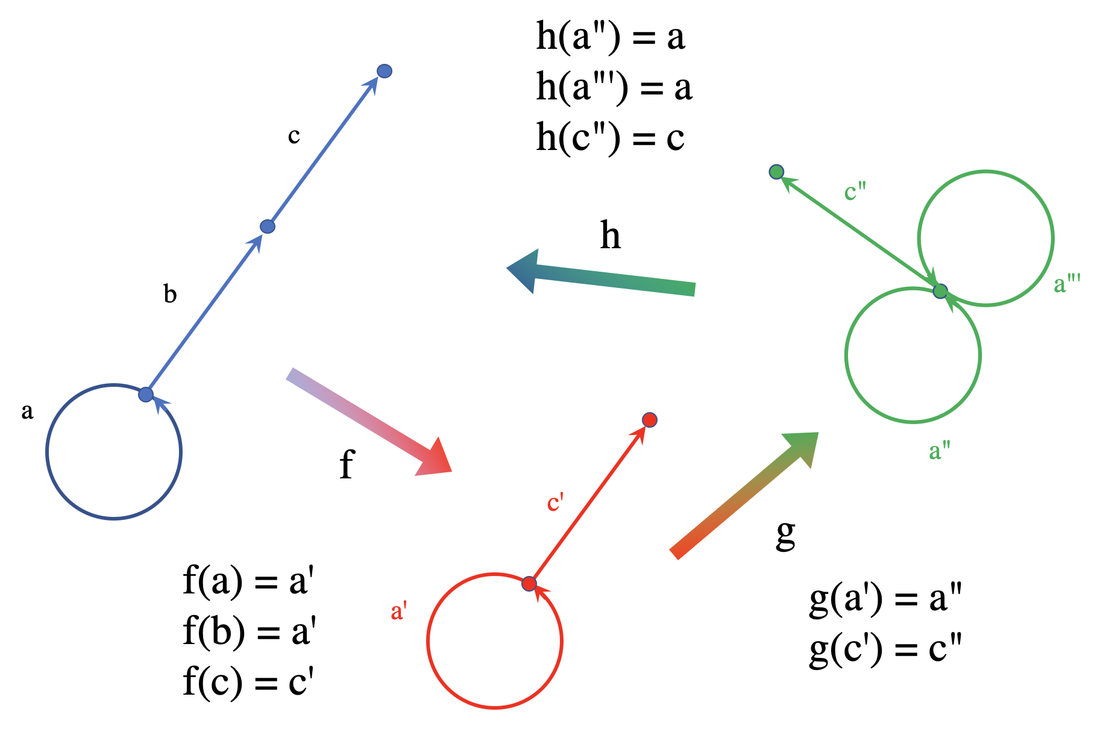
Example 3

Slide 18
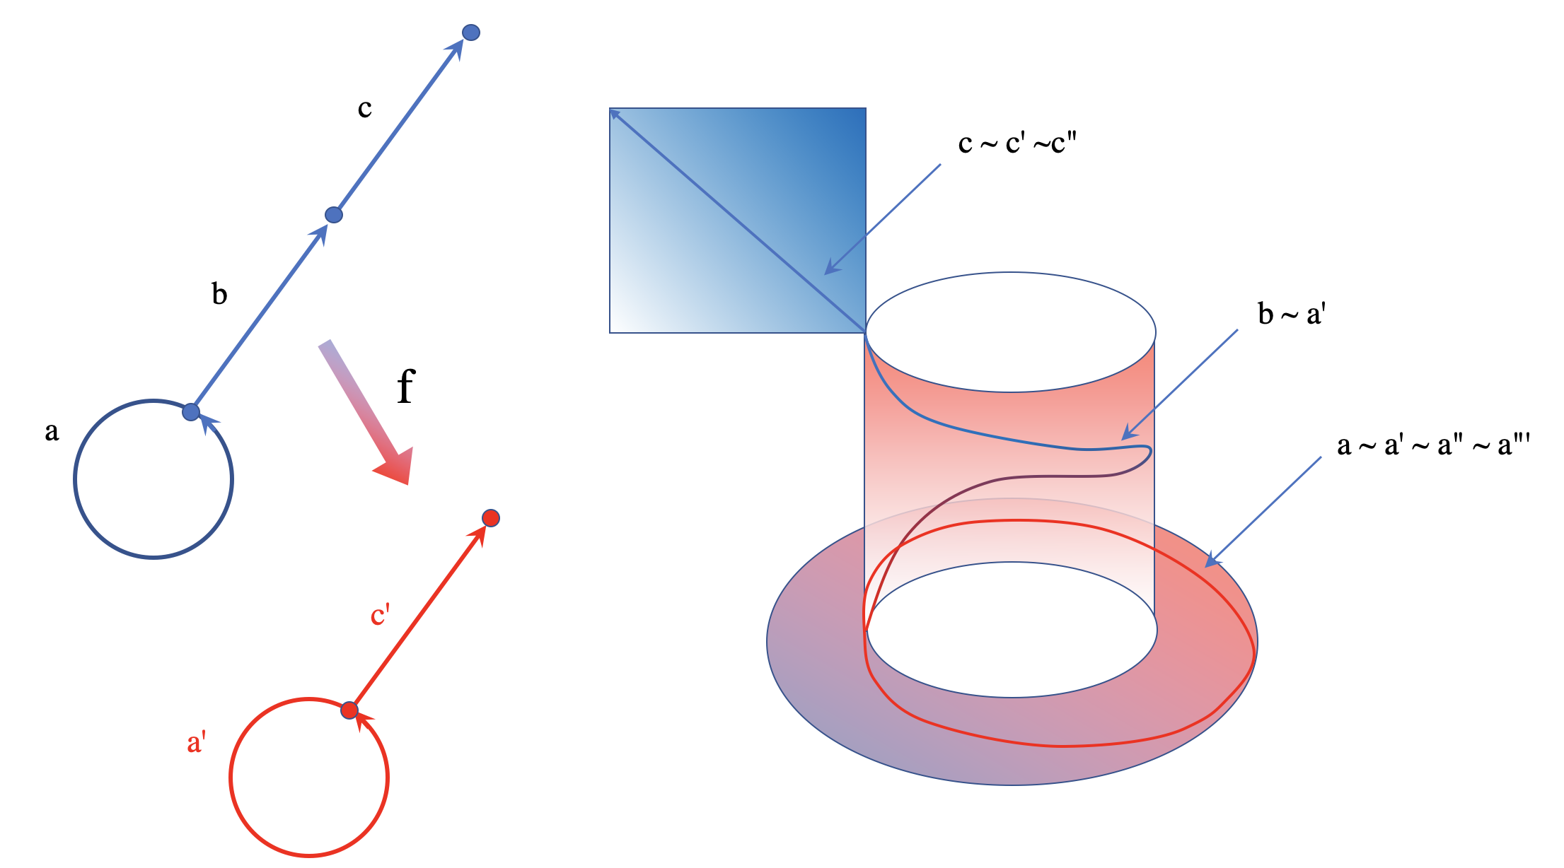
Example 3

Slide 19
VI.4.6 Embedding the Limit’s Domain in Imaginary Space-Time
In Hawking’s physical model, time is a complex number t + i.s, where t is the traditional time value and i.s is the imaginary component. It is not clear at all whether and how this imaginary component could be a part of human consciousness. We conjecture that our presence of consciousness, where thoughts are built and processed, could happen in that imaginary direction, so that the classical real space-time is complemented by an imaginary time-space defined by imaginary time. If physicists are entitled to introduce new time dimensions, there is no reason to prevent artists from doing the same and claiming that creative human consciousness is hosted in such a time-space that is “orthogonal” to the physical one. This means that at any classical physical time t, we would have an entire time-space defined by an imaginary time i.s plus some space coordinates attached to that time.

Slide 20
Based upon arguments for an extra time dimension, we argue that the concept of presence in time-critical arts requires such an imaginary time and space. It is in this realm where the transitional processing of past music to future music, the planning of gestural strategies, the body-instrument-sound interface are all displayed and organized. It is a quite dramatic change of understanding of what happens in the artistic presence, since it eliminates the mystification of spontaneity and imprevisibility in creative performance. These attributes have had a great influence on the non-understanding of creative performance, from classical music to free jazz. Improvisation, creative performance—all of that has been boiled down to these negative concepts:

Slide 21
Spontaneity and imprevisibility are just negations of any sort of positively defined artistic shaping; they are the “emergent properties” of creativity mysticism, creativity by negation. Telling a musician to be spontaneous is of no help whatsoever: It is just a recommendation to rely on nothing that could be conceived of in the artistic-shaping activity.

Slide 22
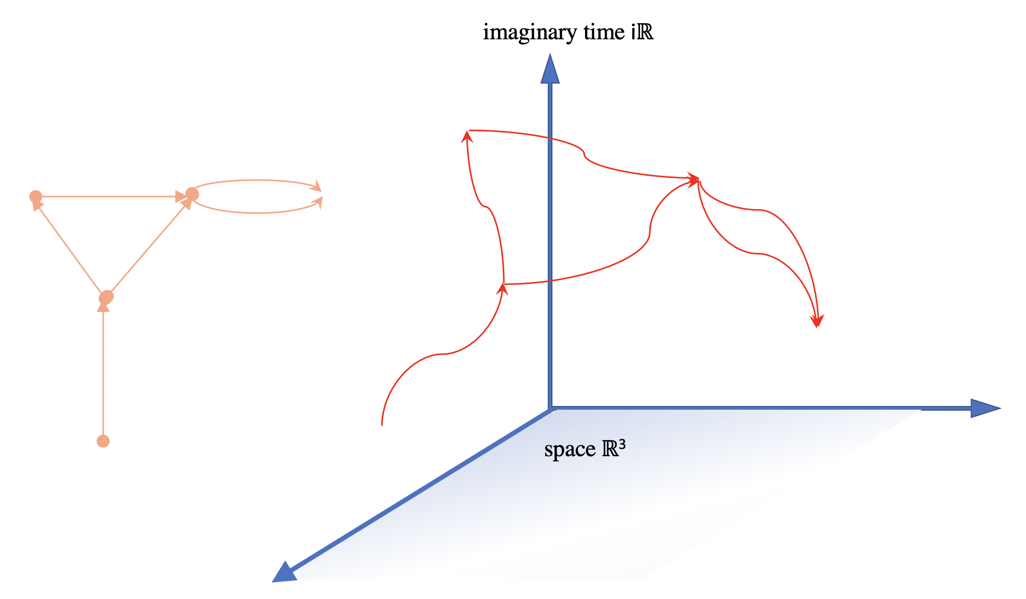
Let us recall the gestural construction of musical
time as being realized with the limit of skeletal
spaces of diagrams of gestures. The question here
is about the realization of such limits in our
space-time reality.
The imaginary time space-time iℝ ⊕ ℝ³ is a four-dimensional vector space where imaginary temporal instances can survive.
imaginary time iℝ
space ℝ³

