Slide 1
VIII The Second Dimension of Gestures
(Fr Mar 01)

Slide 2
VIII.1 Singer‘s Gestures

Slide 3
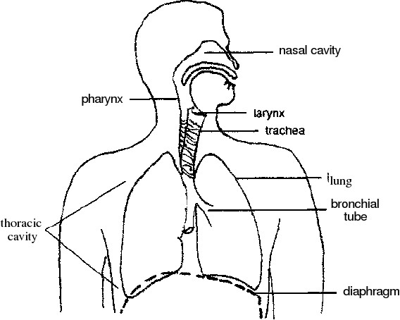
VIII.1.1 The Anatomy of the Voice
diaphragm/lungs
larynx
vocal folds
This sound is then shaped by the manipulation of the various structures along the vocal tract, such as the position of the tongue, and the larynx, etc. The articulators are the cheeks, tongue, teeth and lips and they all contribute to vocal articulation, whereas the sinus, chest, laryngeal and pharyngeal cavities all act as resonating chambers for the voice.

Slide 4
VIII.1.1 The Anatomy of the Voice
diaphragm/lungs

Slide 5
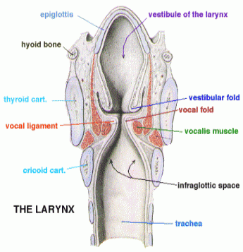
VIII.1.1 The Anatomy of the Voice
larynx

Slide 6
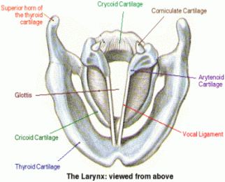
VIII.1.1 The Anatomy of the Voice
vocal folds

Slide 7
VIII.1.2 Singing Gestures as an Inner Embodiment

Slide 8
Formants are frequency filters in the human voice
that are generated by the throat’s variable anatomy
They are responsible for the shaping of speech and singing
Johan Sundberg
KTH Stockholm

Slide 9
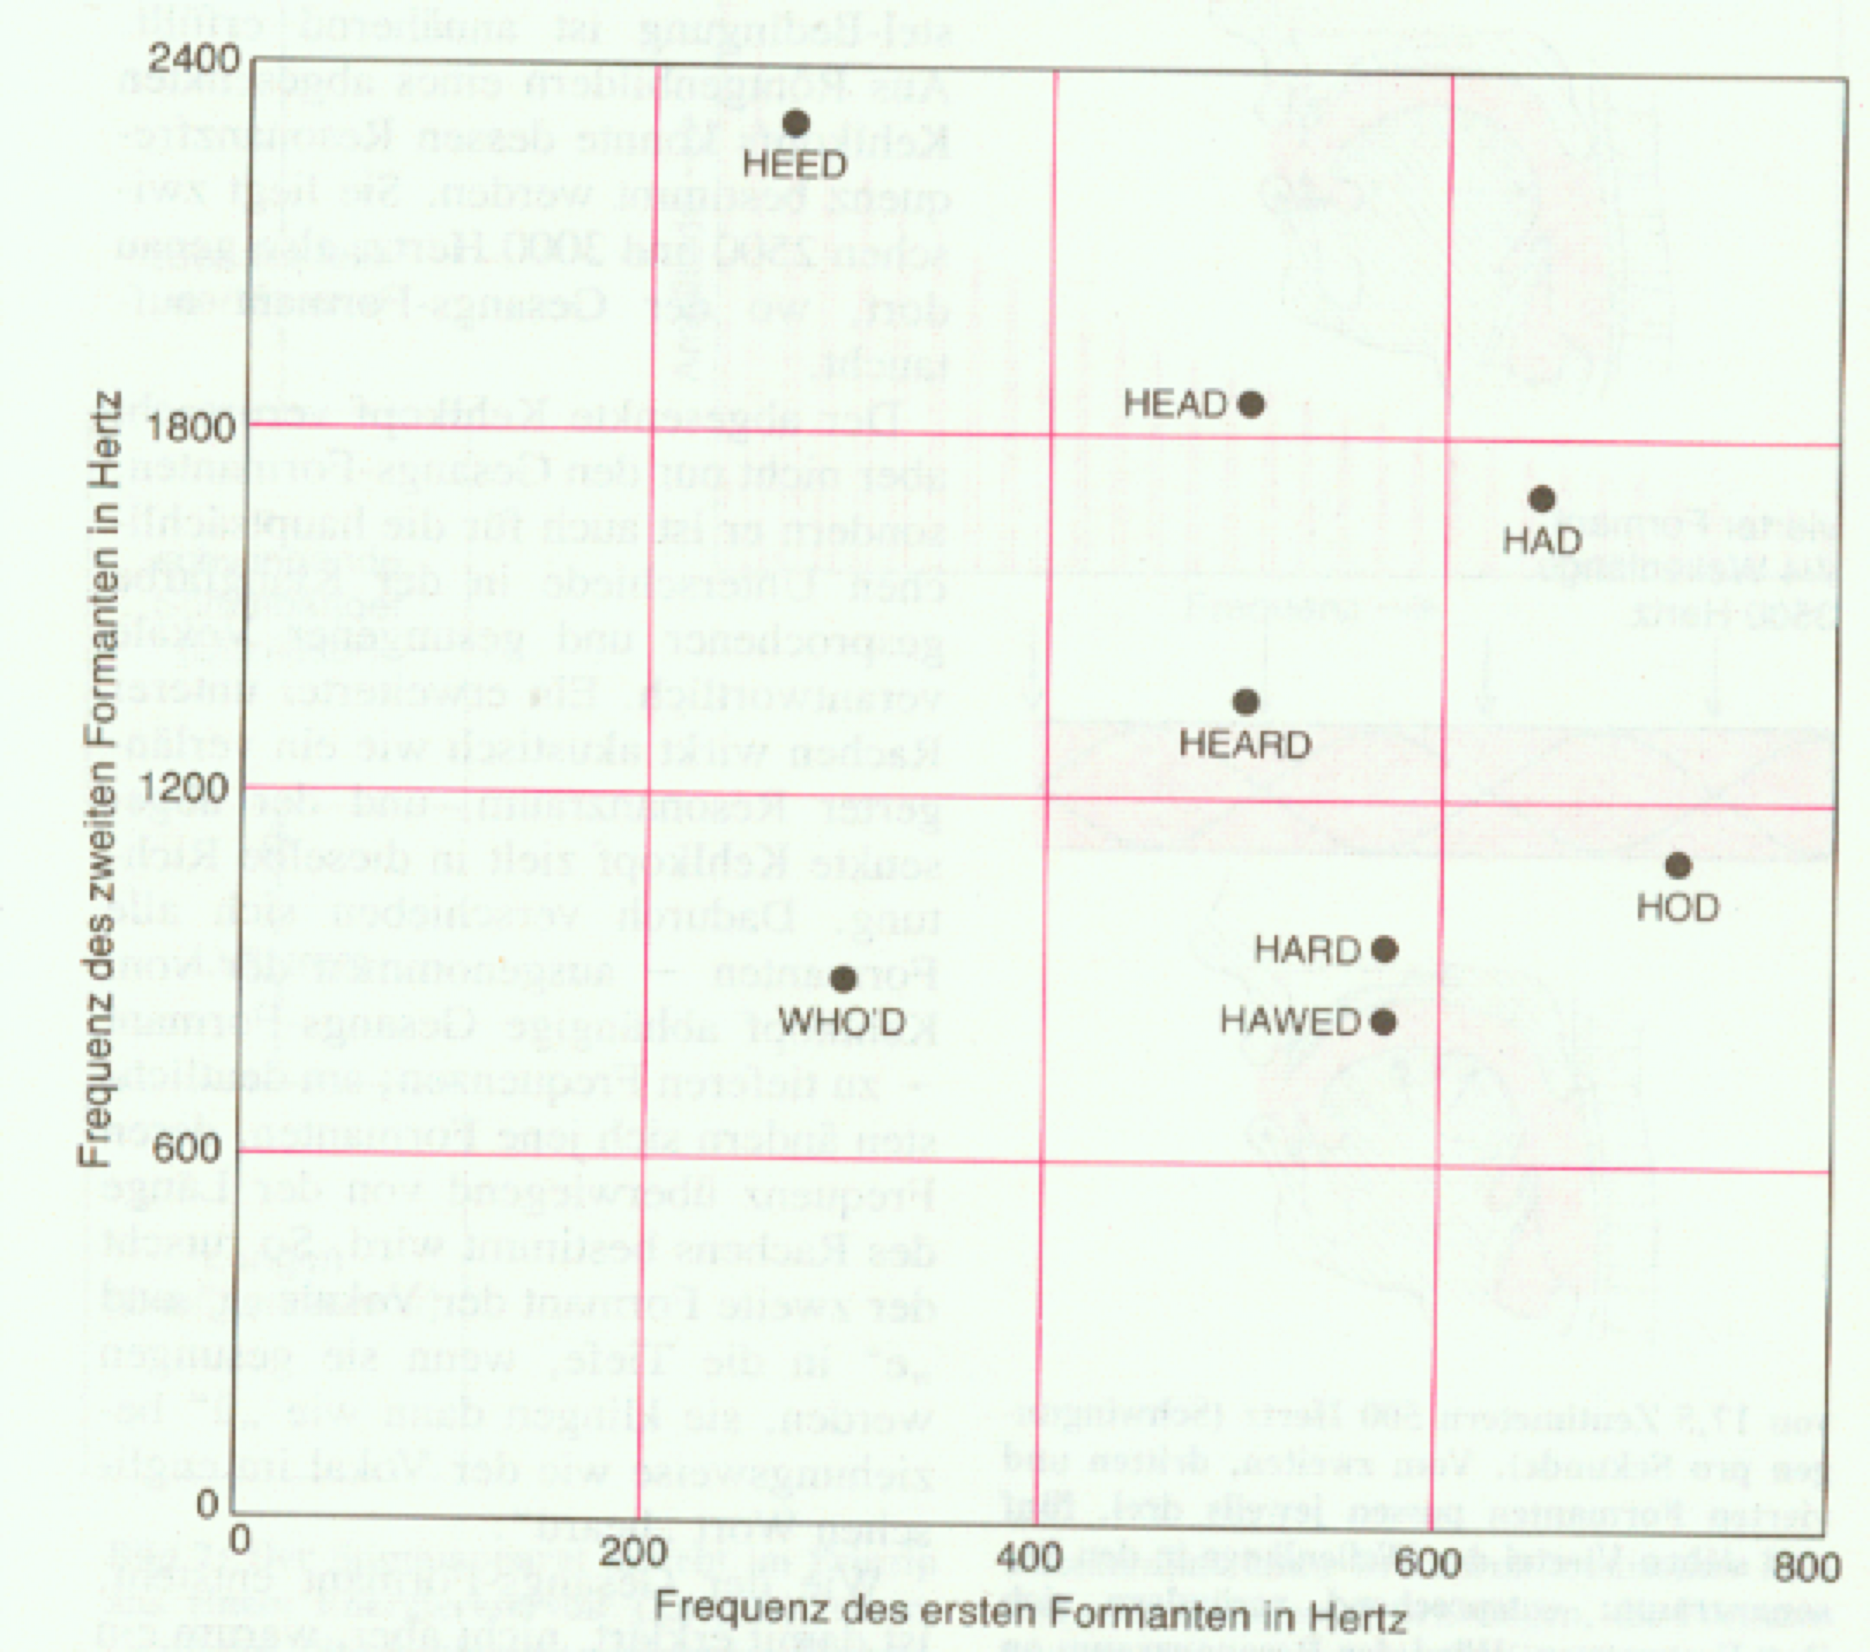
Typical formant pairs of the first two formants (J. Sundberg)

Slide 10
VIII.3 Singer‘s Gestural Body
Matt Rahaim (U of M), Marc Leman (U of Ghent)

Slide 11
VIII.3.1 Matt Rahaim: Singer‘s Gestural Body
in Hindustani Music
his book
Musicking Bodies: Gesture and Voice in Hindustani Music
see also Chapter 85 in The Topos of Music.

Slide 12
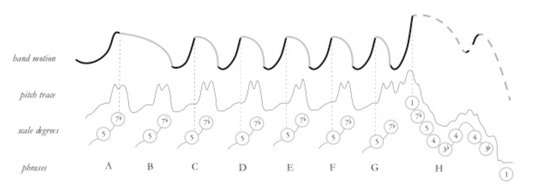
Mariah Carey Vision of Love (1990)
Youtube

Slide 13
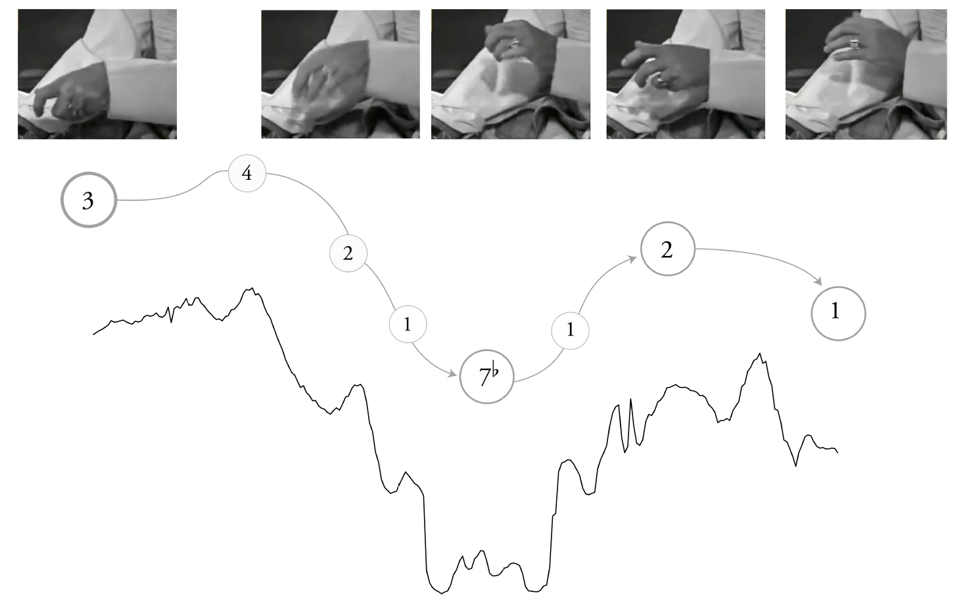
Amir Khan Raga Rageshiri, phrase 1
Youtube for another Raga by Amir Khan
The melody and the hands move in different and
autonomous ways.

Slide 14
VIII.3.2 There is an ontological interpretation of the Raga singing artist‘s gestures: the singing body.
This is shared by Rhaim and Leman, and it claims that the singer creates a new „body“, which is neither the physical body, nor the body of instruments.
The singing body in Cartesian terms is neither res cogitans nor res extensa.
It is neither subjective, nor objective.
In linguistics, the second person has become a subject of research:
I, We subject
You ???
He, she, it, they object

Slide 15
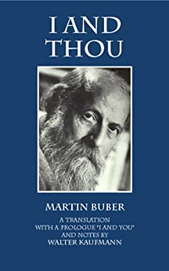
In linguistics, the second person has become a subject of research:
Dialogical dimension:
Martin Buber was an Austrian-born philosopher best known for his philosophy of dialogue, a religious existentialism centered on the distinction between the I-Thou relationship and the I-It relationship. Ich und Du (1923)

Slide 16
Mother and child
love
opposition to idealistic ego-philosophy

Slide 17
The singing body.
This is a gestural existence of dialogical type a „thou“ (you)
It is neither subjective, nor objective.
Question:
Is gesturality sharing a dialogical ontology?

