Slide 1
IX.1 Software for Gestural Music Management
(Fr Mar 22)

Slide 2
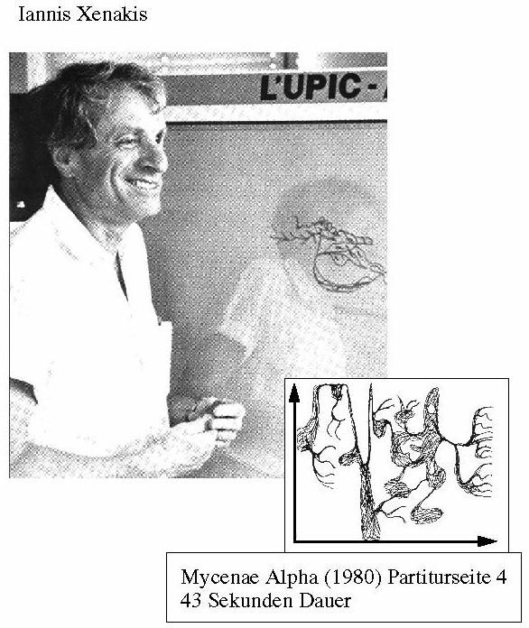
IX.1.1 Gestural Creation of Graphical Compositions (in memoriam Xenakis)
Mycenae Alpha

Slide 3
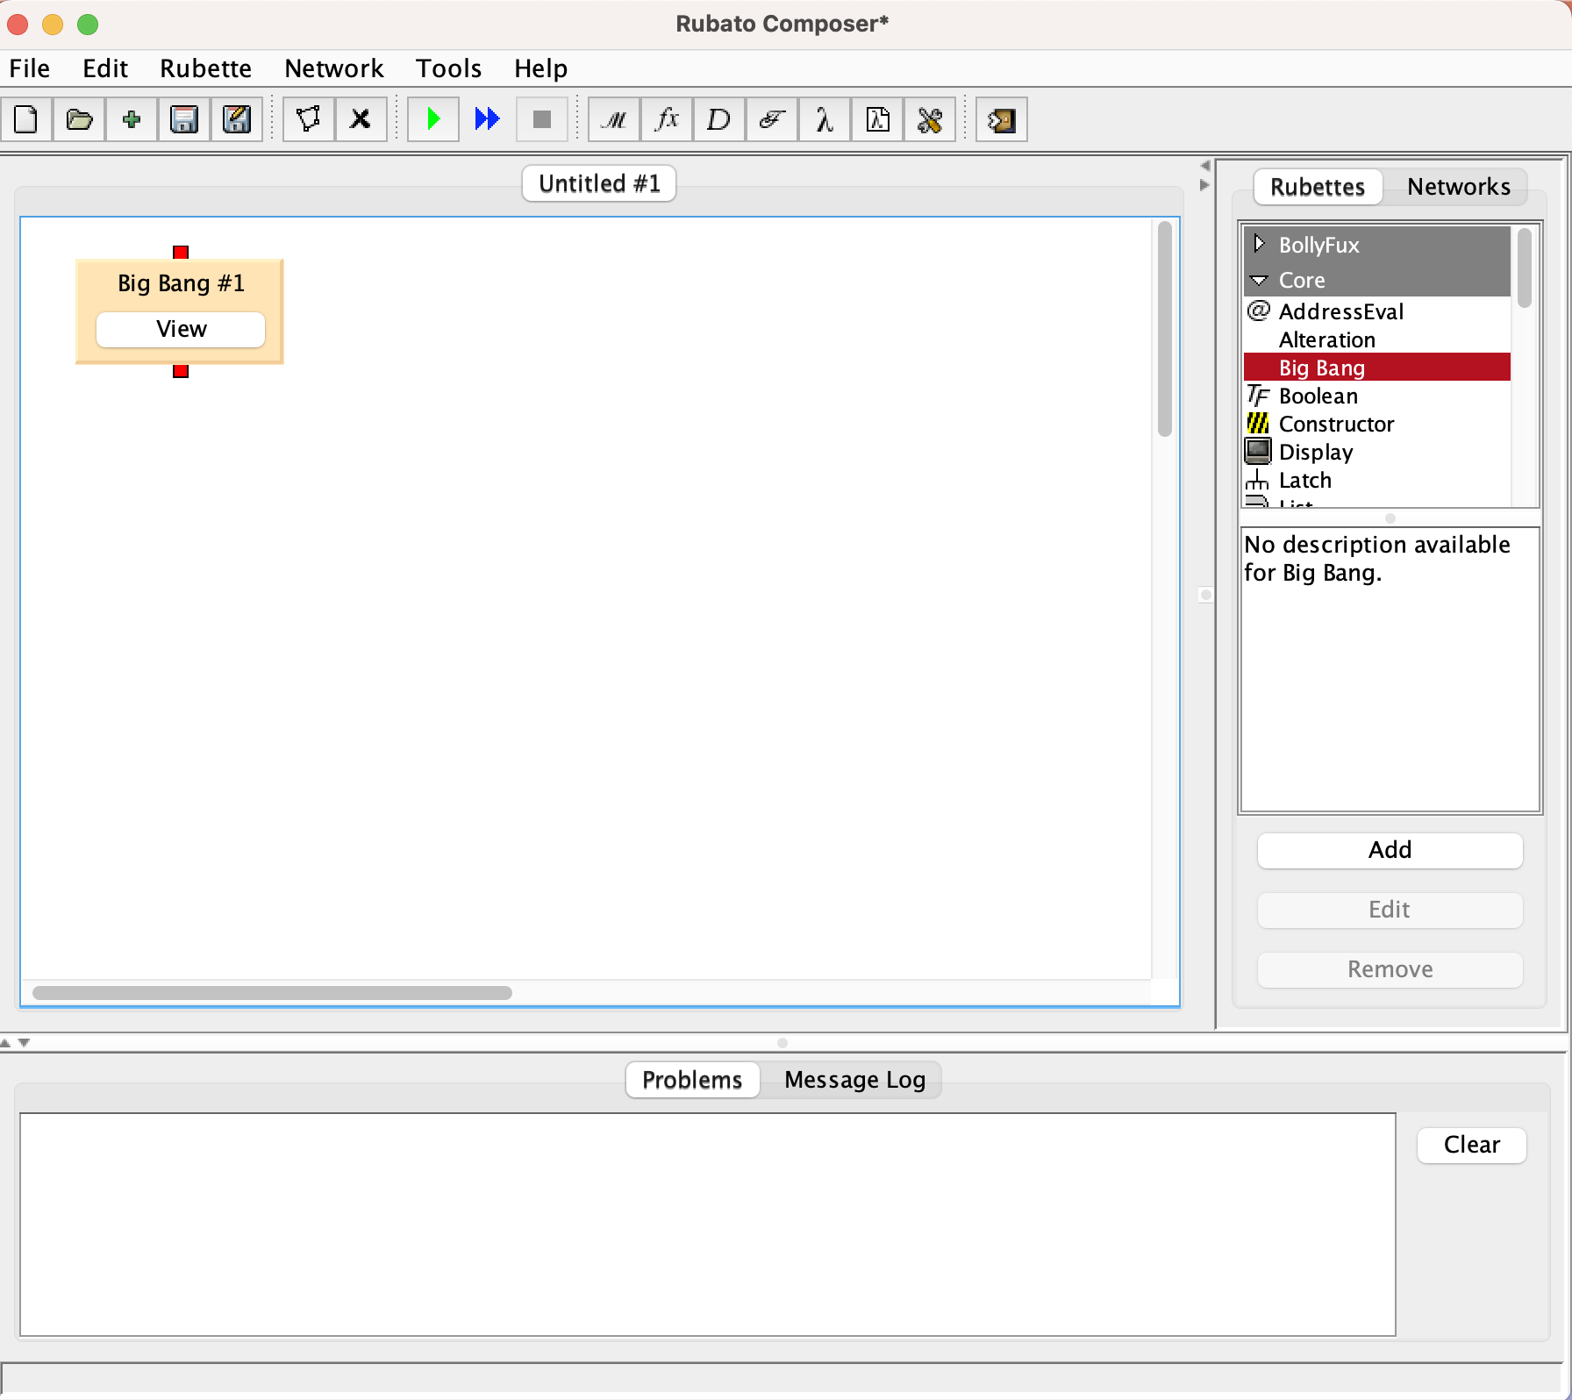
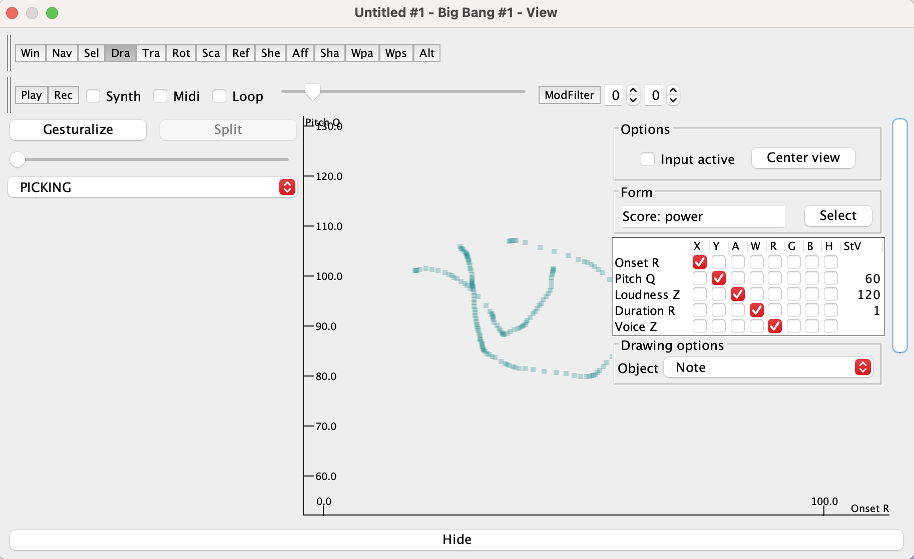
IX.1.2 Florian Thalmann’s Big Bang Rubette in the Rubato Software Environment

Slide 4
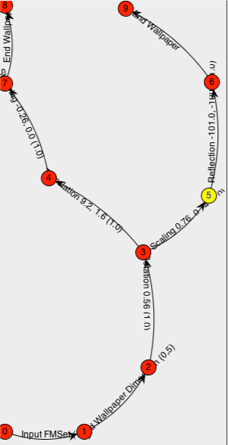
IX.1.2 Tracing the Compositional Pathway together with its gesturalization

Slide 5
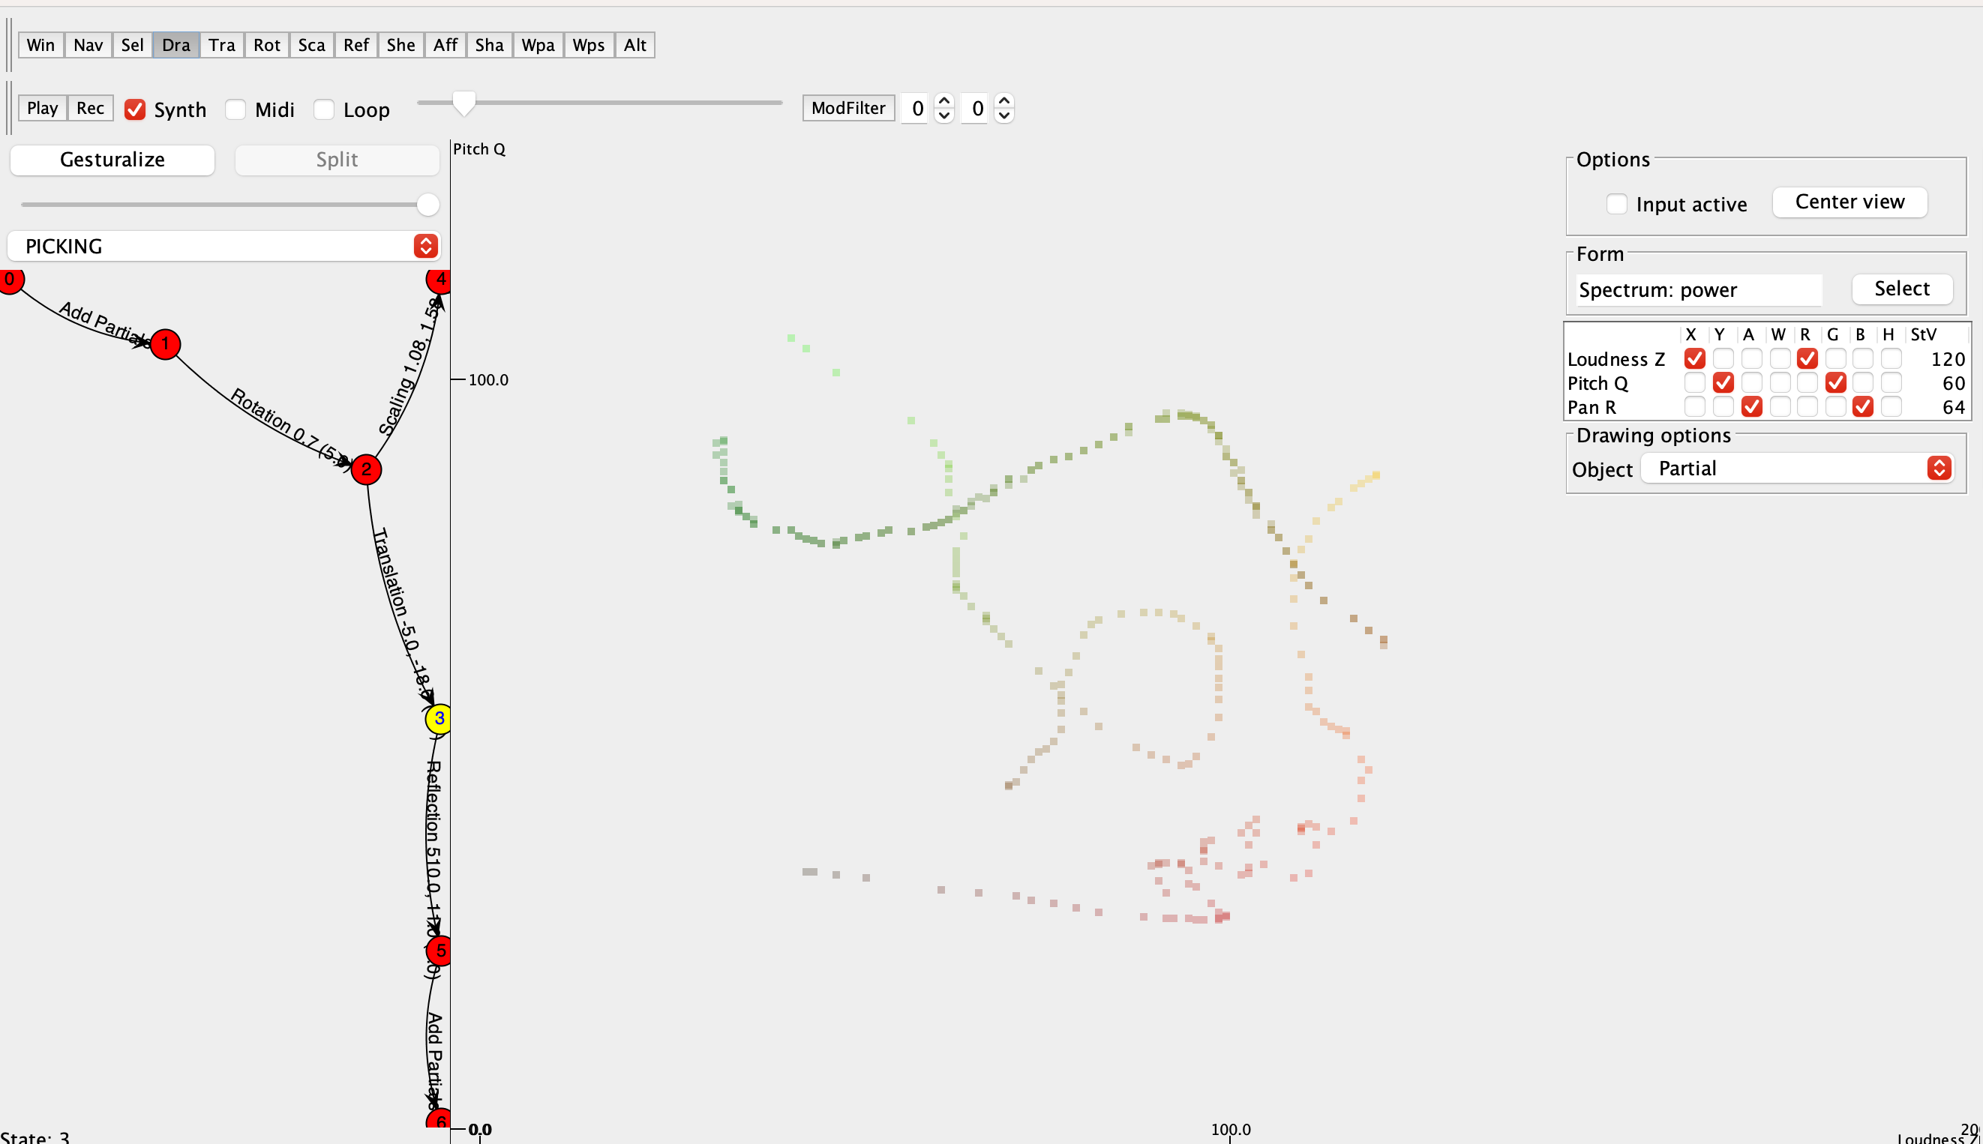
Florian Thalmann‘s BigBang
Gestural composition on spectral drawings

Slide 6
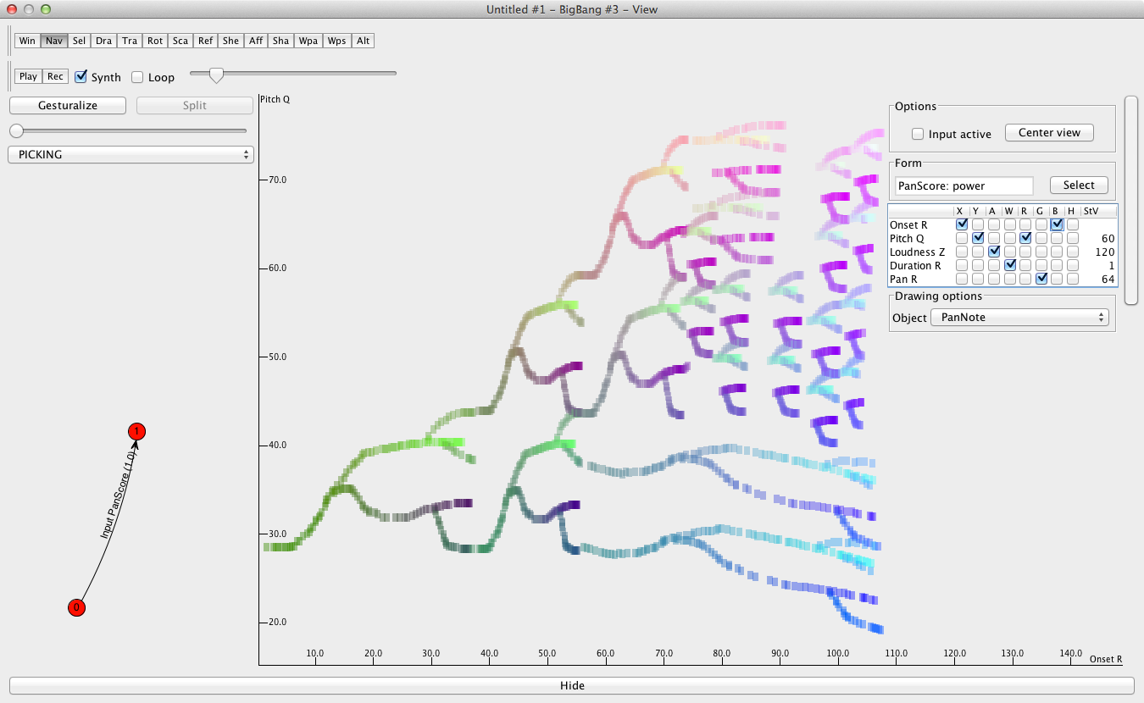
IX.1.2 Gestural Creation of Graphical Compositions
https://soundcloud.com/bigbangrubette/upic

Slide 7
Florian Thalmann‘s BigBang with Leap Motion
://www.youtube.com/watch?v=ytGcKfhzF2Q

Slide 8
Gesture Software resources
Marcello Wanderley‘s contributions at IRCAM
Mary Mainsbridge and Kirsty Beilharz
Atau Tanaka
etc.
will discuss separately

Slide 9
IX.1.3 Formal Concept Frameworks for Music:
Forms, denotators for modules: compositions
Forms, denotators for digraphs: gestures

Slide 10
Forms, denotators for modules: compositions
Software for music in composition, analysis, and performance needs to construct formal representations of its objects and processes.
This has been achieved for classical approaches to music by the system of forms and denotators for compositions. We give a summary of this approach, which was implemented in the Rubato software.

Slide 11
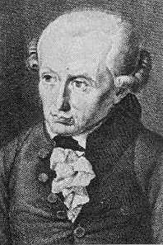
(Kritik der reinen Vernunft, B 324) Man kann einen jeden Begriff, einen jeden Titel, darunter viele Erkenntnisse gehören, einen logischen Ort nennen. You may call any concept, any title (topic) comprising multiple knowledge, a logical site.
Immanuel Kant
concepts are points in concept spaces

Slide 12
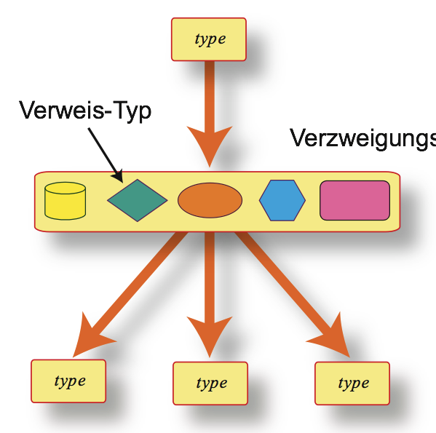
ramification type ~ completeness
reference ~ unity
linear ordering ~ discourse

Slide 13
<denotator_name><form_name>(coordinates)
denotator
form
D₁
<form_name><type>(coordinator)
F₁
D_{s-1}
F_{n}
D_{s}

Slide 14
Simple Forms = Elementary Spaces

Slide 15
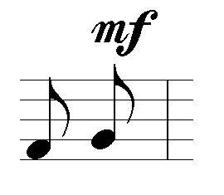
Simple 1
<form_name><type>(coordinator)
A = STRG = set of strings (words) from a given alphabet
example:
‘Loudness’
Simple
<denotator_name><form_name>(coordinates)
a string of letters
example:
mf
example:
‘mezzoforte’

Slide 16
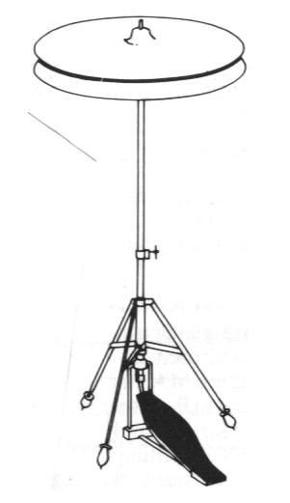
Simple 2
<form_name><type>(coordinator)
A = Boole = {NO, YES} (boolean)
example:
‘HiHat-State’
Simple
<denotator_name><form_name>(coordinates)
boolean value
example:
YES
example:
‘openHiHat’

Slide 17
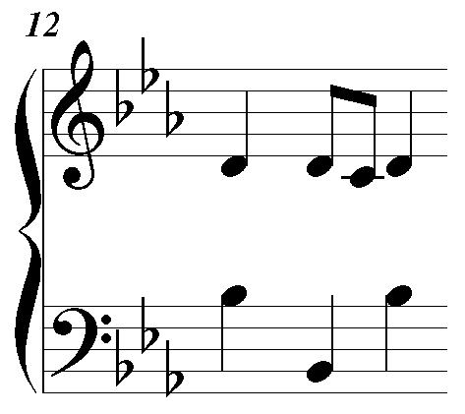
Simple 3
<form_name><type>(coordinator)
A = integers Ÿ = {...-2,-1,0,1,2,3,...}
example:
‘Pitch’
Simple
<denotator_name><form_name>(coordinates)
integer number
from Ÿ
example:
b-flat ~ 58
example:
‘thisPitch’

Slide 18
Simple 4
<form_name><type>(coordinator)
A = real (= decimal) numbers —
example:
‘Onset’
Simple
<denotator_name><form_name>(coordinates)
real number
from —
example:
11.25
example:
‘myOnset’

Slide 19
Simple +
<form_name><type>(coordinator)
Extend to more general mathematical spaces M!
example:
‘Eulerspace’
Simple
<denotator_name><form_name>(coordinates)
point in
M
e.g. Euler pitch spaces....
third
example:
‘myEulerpoint’
octave
fifth

Slide 20
<form_name><type>(coordinator)
A module M over a ring R (e.g., a real vector space)
Simple
Examples:
M = —³ space for space music description
M = –³ pitch space o.log(2) + f.log(3) + t.log(5)
M = Ÿ₁₂, Ÿ₃, Ÿ₄ for pitch classes
M = Ÿ ×Ÿ₃₆₅ × Ÿ₂₄ × Ÿ₆₀ × Ÿ₆₀ × Ÿ₂₈ (y:d:h:m:s:fr) for time
M = ¬, Polynomials R[X] etc. for sound, analysis, etc.
<PitchClass><Simple>(Ÿ₁₂)

Slide 21
Compound Forms = Recursive Spaces

Slide 22
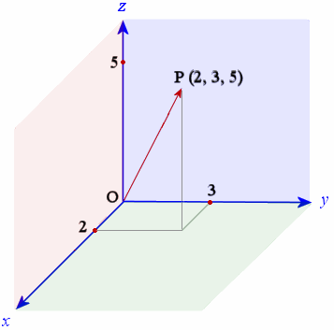
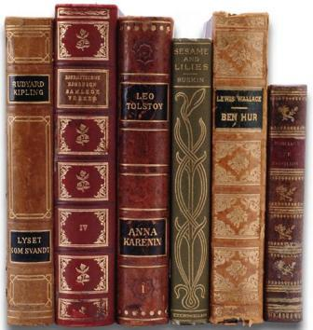
spaces/forms
exist three compound space types:
product/limit
union/colimit
collections/powersets

Slide 23
<form_name><type>(coordinator)
sequence F₁, F₂,... F_{n} of n forms
example:
‘Note’
Limit
<denotator_name><form_name>(coordinates)
n denotators from F₁, F₂,... F_{n}
example (n=2):
(‘myOnset’,’thisPitch’)
example:
‘myNote’

Slide 24
<form_name><type>(coordinator)
F₁
extend to diagram of
n forms + functions
F_{n}
F_{i}
example:
‘Interval’
Limit
K-nets (networks!)
<denotator_name><form_name>(coordinates)
n denotators, plus arrow conditions
example:
(‘note₁’,’on’,’note₂’)
Note Onset Note
example:
‘myInterval’

Slide 25
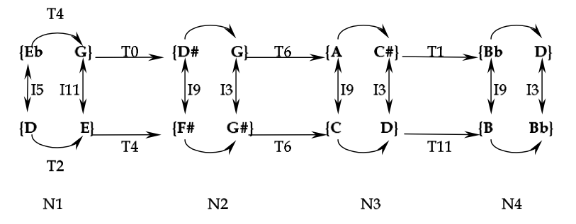
Klumpenhouwer (hyper)networks
J₁
J₂
J₃
J₄
Db}

Slide 26
3
7
∈
T⁴
∈
Ÿ₁₂
Ÿ₁₂
T⁵.-1
T¹¹.-1
Ÿ₁₂
Ÿ₁₂
∈
T²
∈
2
4
Ÿ₁₂
Ÿ₁₂
T⁴
limit
T⁵.-1
T¹¹.-1
Ÿ₁₂
T²
Ÿ₁₂

Slide 27
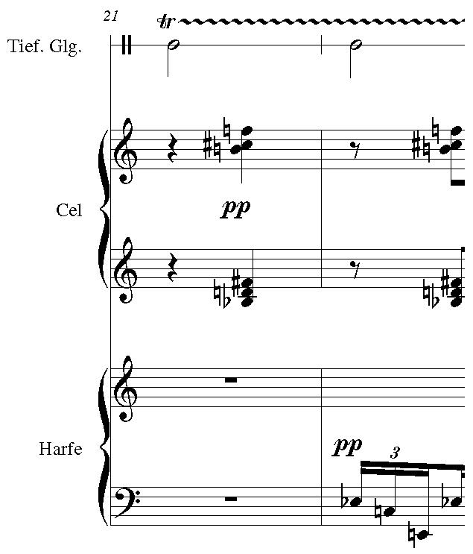
<form_name><type>(coordinator)
sequence F₁, F₂,... F_{n} of n forms
example:
‘Orchestra’
Colimit
<denotator_name><form_name>(coordinates)
one denotator for i-th form F_{i}
example:
Select a note from celesta
example:
‘mySelection’

Slide 28
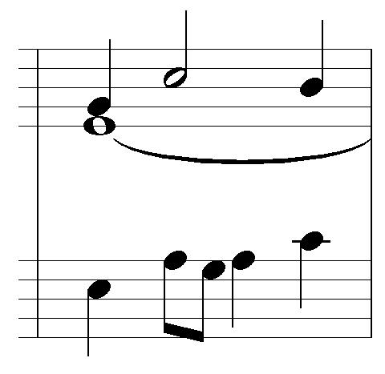
Power 1
<form_name><type>(coordinator)
one form F
Example:
‘Motif’
Powerset
<denotator_name><form_name>(coordinates)
A set of
denotators
of form F
example:
{n₁,n₂,n₃,n₄,n₅}
example:
‘thisMotif’
F = Note

Slide 29
Power 2
<form_name><type>(coordinator)
one form F
Example:
‘Chord’
Powerset
<denotator_name><form_name>(coordinates)
A set of
denotators
of form F
example:
{p₁,p₂,p₃}
example:
‘thisChord’
F = PitchClass

Slide 30
<form_name><type>(coordinator)
F₁
diagram of
n forms
F_{n}
F_{i}
Colimit
Idea: take union of all F_{i} and identify corresponding points under the given maps.
Gluing together spaces
of musical objects!

Slide 31
<form_name><type>(coordinator)
Colimit
F₁
T^{n}
F_{n}
D =
Chord
F_{i}
T^{n}{c₁,c₂,...,c_{k}} = {n+c₁, n+c₂,..., n+c_{k}} mod 12 (transposition by n semitones)
Result = set of n-transposition chord classes!
BTW: What would the Limit of D be?

Slide 32
Note form
Note
Onset
Pitch
Loudness
Duration
—
Ÿ
STRG
—

Slide 33
GeneralNote form
GeneralNote
Pause
Note
Onset
Duration
Onset
Pitch
Loudness
Duration
—
—
—
Ÿ
STRG
—

Slide 34
FM-Synthesis

Slide 35
FM-Synthesis
FM-Object
Node
Support
Modulator
Amplitude
Frequency
Phase
FM-Object
—
—
—

Slide 36
FM-Synthesis
FM-Object
Node
Support
FM-Object
Amplitude
Frequency
Phase
—
—
—

Slide 37
Embellishments
Schenker Analysis GTTM Composition
hierarchies!
?

Slide 38
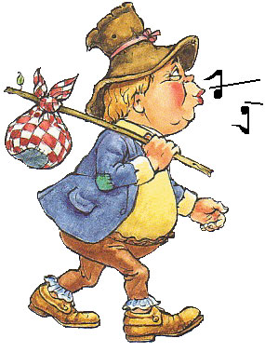
Nodify
score
macroscore
Flatten
Note
node
Note
macroscore
onset
pitch
loudness
duration
voice
—
Ÿ
STRG
—
Ÿ

Slide 39
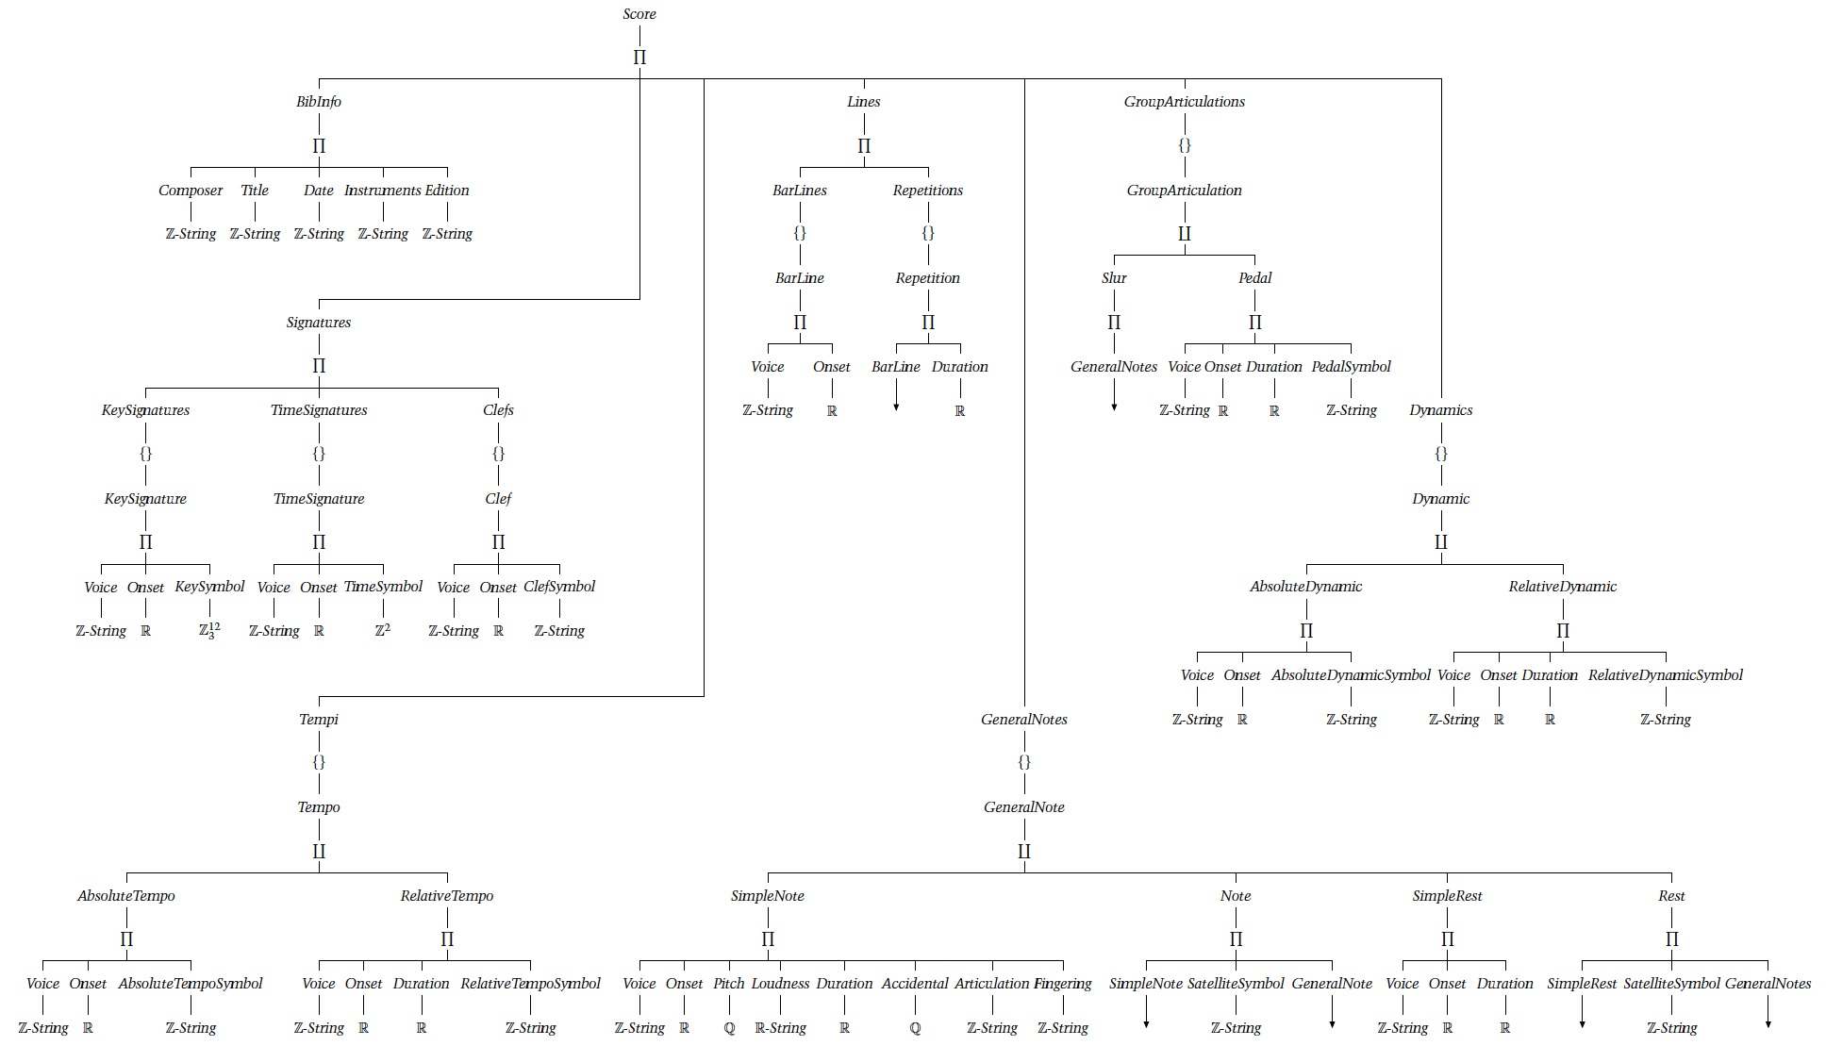
a score form by Mariana Montiel

Slide 40
The denoteX notation for forms and denotators

Slide 41
Forms
Name:.TYPE(Coordinator);
Name = word (string)
TYPE = one of the following: - Simple - Limit - Colimit - Powerset
Coordinator = one of the following: - TYPE = Simple: STRING, Boole, Ÿ, — - TYPE = Limit, Colimit: A sequence F₁,... F_{n} of form names - TYPE = Powerset: One form name F

Slide 42
Denotators
Name:@FORM(Coordinates);
Name = word (string)
FORM = name of a defined form
Coordinates = x, which looks as follows: - FORM:.Simple(F), then x is an element of F (STRING, Boole, Ÿ, —)
- FORM:.Powerset(F), then x = {x₁, x₂, x₃,... x_{k}} x_{i} = F-denotators, only names x_{i}:
- FORM:.Limit(F₁,... F_{n}), then x = (x₁, x₂, x₃,... x_{n}) x_{i} = F_{i}-denotators, i = 1,...n
- FORM:.Colimit(F₁,... F_{n}), then x = denotator of one F_{i} (i>x, only names x:)

Slide 43
Exercise:
A FM form and a denotator for this function: f(t) = -12.5 sin(2π5t+3)+cos(t -sin(6πt+sin(πt+89)))
FM-Object
Node
Support
FM-Object
Amplitude
Frequency
Phase
—
—
—

Slide 44
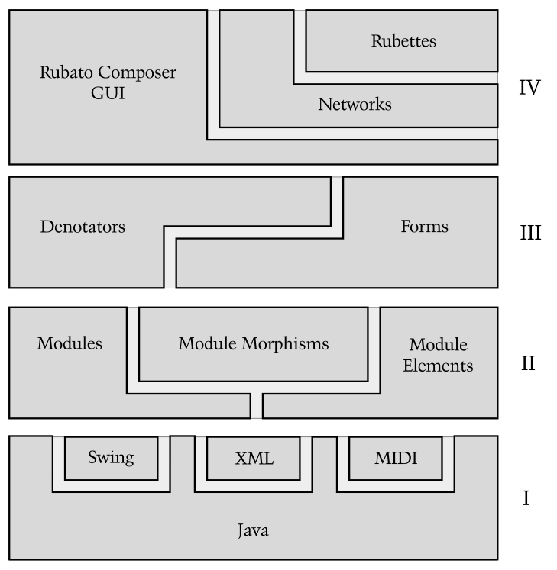

Slide 45
A. More General Denotators Take a module M and define M-addressed denotators
Name:M@FORM(Coordinates);
Name = word (string)
FORM = name of a defined form
Coordinates = x, which looks as follows: - FORM:.Simple(N), then x is an element of Aff(M,N), i.e. an affine function x:M—>N (any module N)
- FORM:.Powerset(F), then x = {x₁, x₂, x₃,... x_{k}} x_{i} = F-denotators, only names x_{i}:
- FORM:.Limit(F₁,... F_{n}), then x = (x₁, x₂, x₃,... x_{n}) x_{i} = F_{i}-denotators, i = 1,...n
- FORM:.Colimit(F₁,... F_{n}), then x = denotator of one F_{i} (i>x, only names x:)
Affine functions
x = T^{t}.f:M—>N—>N
f linear, T^{t}
transposition by
t ∈N

Slide 46
a) B More General Denotators: Examples
Denotator Name = Row (string)
FORM = PitchClassComposition
Coordinates = x, which looks as follows:
PitchClassComposition:.Simple(ℤ ₁₂),
then x is an affine function x:ℤ¹¹—>ℤ ₁₂
x(e_{i}) = row‘s ith element.
Row: ℤ¹¹ @ PitchClassComposition(x);
e₀ = 0
e₁ = (1,0...0)
...
e₁₁ = (0,..0,1)
ℤ¹¹—>ℤ ₁₂
_{p* p}
ℤ¹¹—>ℤ _{12p}

Slide 47
b) Forms and denotators for digraphs: gestures
For a gesture g, we have a defining digraph morphism
g: 𝚫 —> X
instead of an affine morphism between modules. So a gestural denotator of simple type is this:
MyGesture:𝚫@Gesture(g)
with form
Gesture:.Simple(X)
→
→

Slide 48
Hierarchy of forms for gestures:
So for gestures, we have the same compound form types: limit, colimit, and powerset.
But the simple gestural forms are all defined for spatial digraphs X of topological spaces X.
Limit Colimit Powerset compound forms
Simple Gesture simple gestural forms
→
Simple Composition Simple module forms

Slide 49
Some hyper-denotators for compositions and gestures:
hyper-denotators for compositions - c ∈ ℤ^{d} @ ℤ¹¹ @ ℤ₁₂ = Hom(ℤ^{d} , Hom(ℤ¹¹, ℤ₁₂), a d+1-sequence of 12-tone rows (address = ℤ^{d} )
hypergestures - performance hypergestures: p ∈↑@ℝ^{EHLD} ⁻ performance deformation q ∈↑@↑@ℝ^{EHLD}
here, ↑@ℝ^{EHLD} is a topological space, so we may continue!

Slide 50
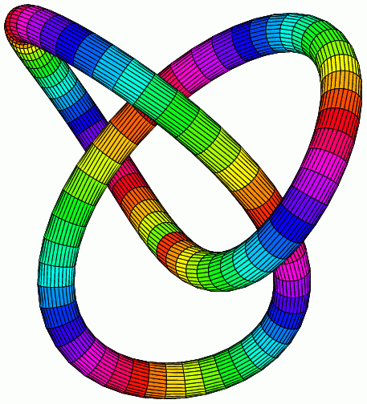
→
Γ @X = topological space of gestures of directed graph Γ in a topological space X
Hypergestures!
„loop of loops “
knot
circle

Slide 51
hypergestures
time
space
space
Space-time X

Slide 52
The Escher Theorem:
Let p be a permutation of numbers 1,2,...n.
hyper-denotators for compositions - for a sequence of modules M₁, M₂,... M_{n}, M we have a isomorphism
M₁@M₂ @... M_{n} @ M ≌ M_{p1}@M_{p2} @... M_{pn} @ M
hypergestures - for a sequence of digraphs Δ₁, Δ₂,... Δ_{n}, and space X we have a isomorphism
Δ₁@Δ₂ @... Δ_{n} @ X ≌ Δ_{p1}@Δ_{p2} @... Δ_{pn} @ X
Example: counterpoint!
→
→
→
→
→
→

Slide 53
