Slide 1
II Structure Theory of Gestures
II.1 The Category of Gestures (following de Saint Victor’s definition)
(Mo Jan 29)

Slide 2
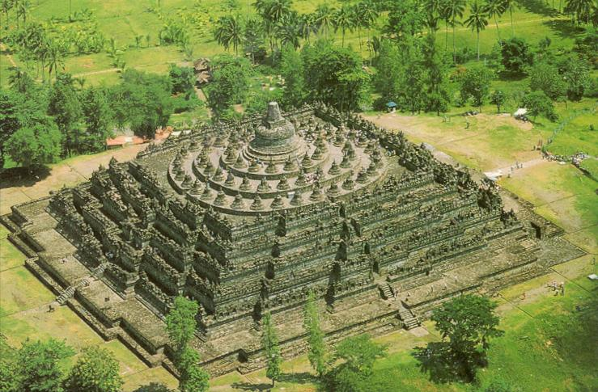
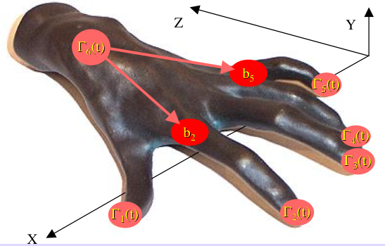
The Oniontology of Music
realities
communication
Facts
signs
Processes
Gestures

Slide 3
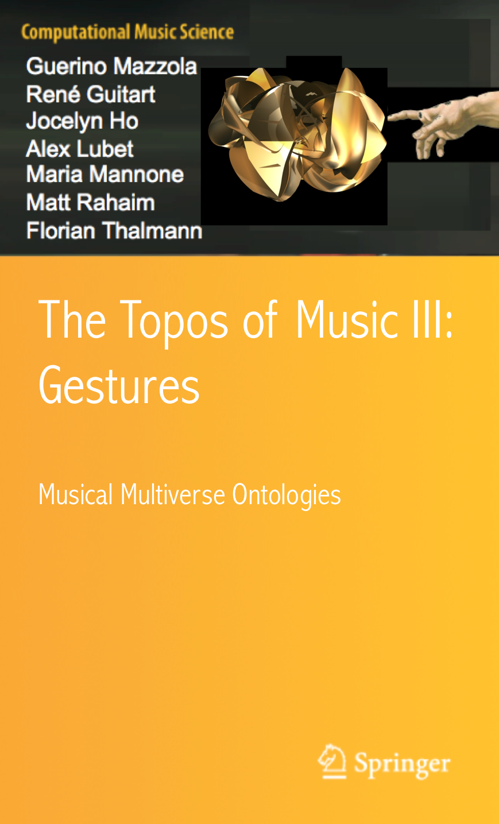
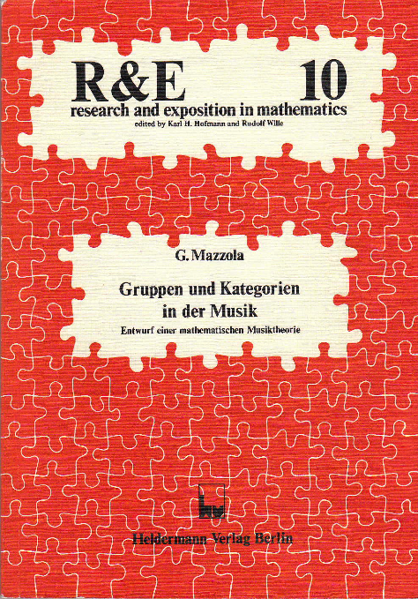
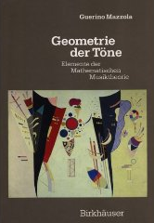
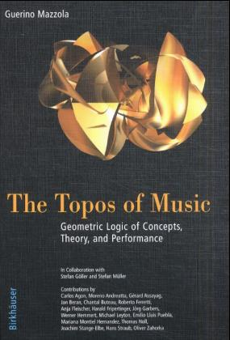
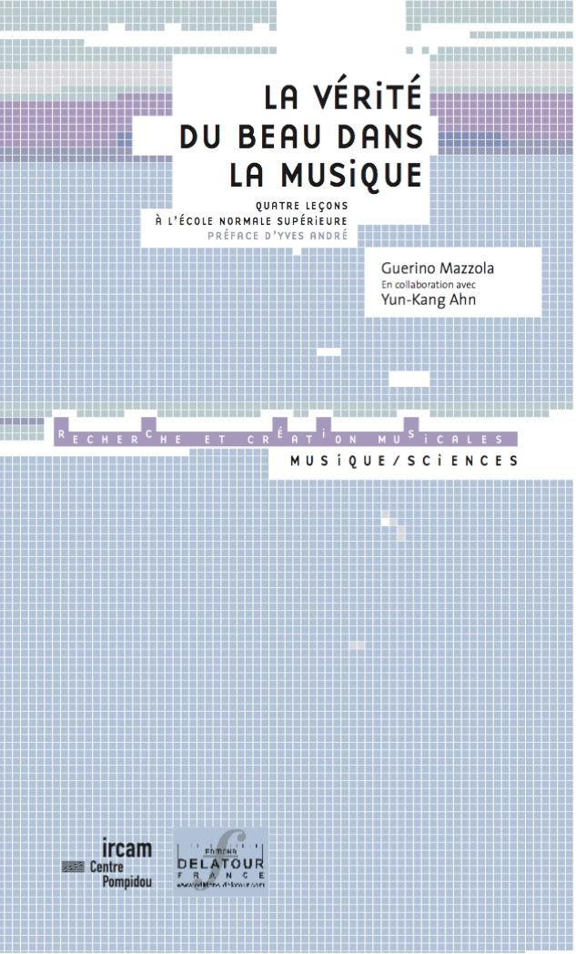
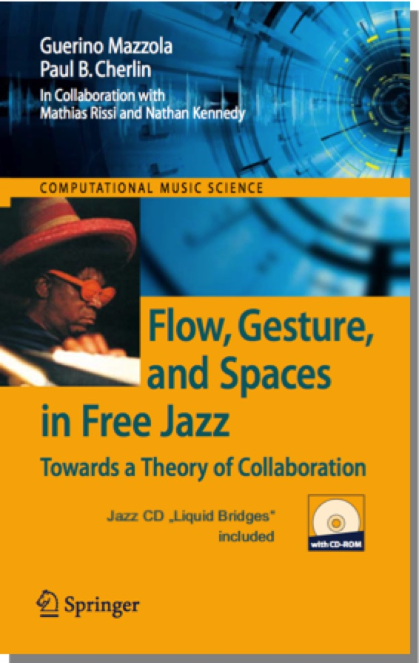
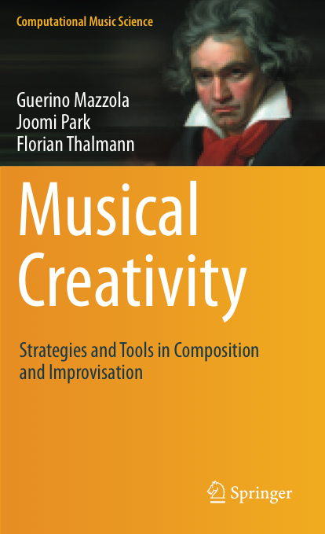
Three Theory and Software Phases
Facts
1982-1992
Geometry and Groups
prestoⓇ
(Atari)
Processes
1992-2002
Functors and Topoi
RubatoⓇ (NeXT & Mac)
Gestures
2002-2012
Algebraic Topology
Rubato Composer
(Java)
2016

Slide 4
Gestures
their definition following St Victor‘s definition

Slide 5
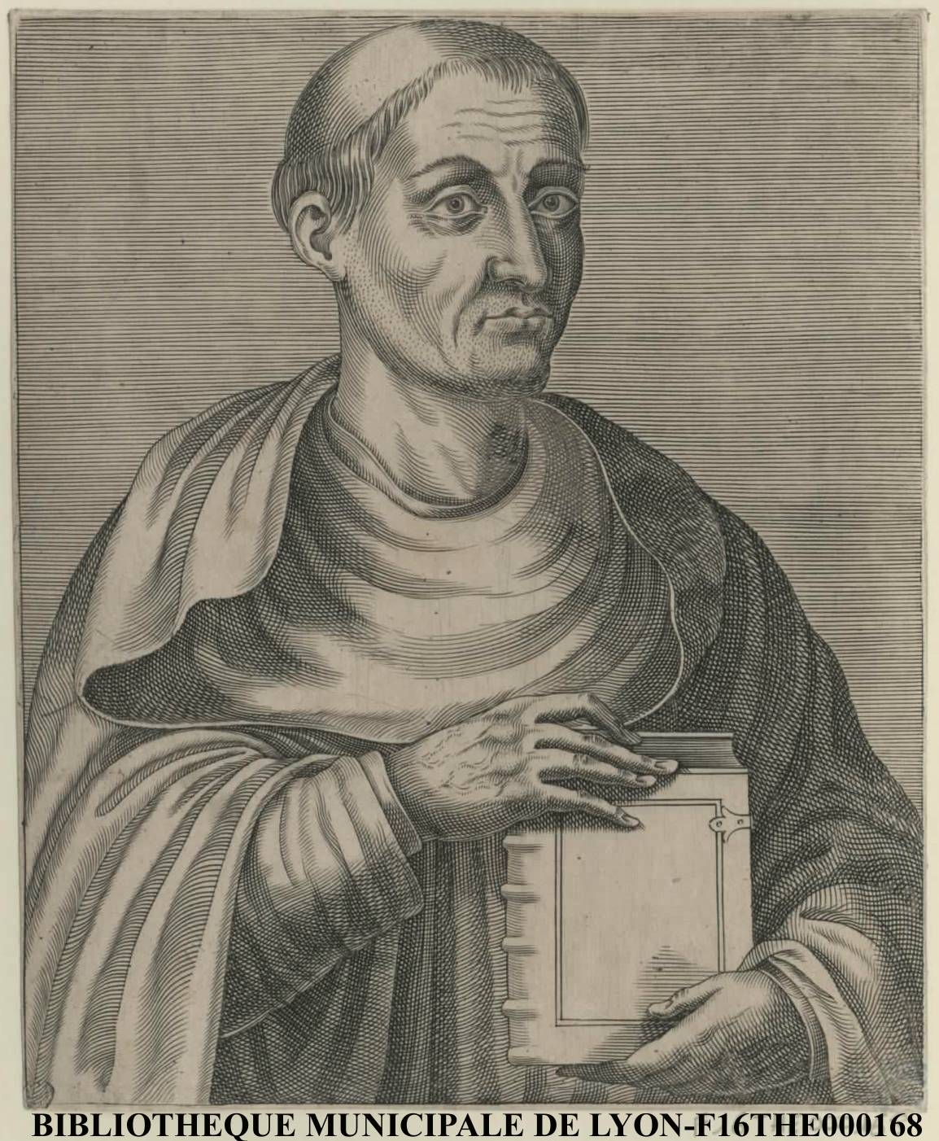
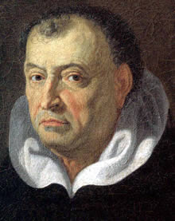
Origins of gesture philosophy:
Hugues de Saint-Victor gives a most adequate definition:
“Gestus est motus et figuratio membrorum corporis, ad omnem agendi et habendi modum.” (Gesture is the movement and figuration of the body’s limbs with an aim, but also according to the measure and modality proper to the achievement of all action and attitude.)
Hugues de Saint-Victor
(1097-1141)
Tommaso Campanella : (Philosophia Rationalis 1637-38, Paris, Du Bray):
“...omnes propositiones per singulares tamquam ad digitum exponuntur.” (...pointing with your finger is the only certitude)
Tommaso Campanella
(1565-1639)

Slide 6
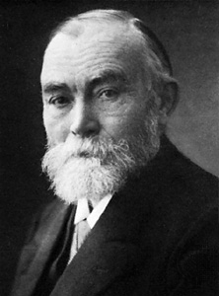
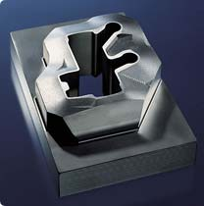
The Fregean drama: Fonctions are the „phantoms“ (the prisons?) of gestures.
Gottlob Frege 1848-1925
Y
f(x)
f(x)
f(x)
teleportation
(x)
(x
x
x
X

Slide 7
algebra compactifies gestures to symbolic formulas
rotation
matrix equation
a₁₁x+a₁₂y+a₁₃z = a
a₂₁x+a₂₂y+a₂₃z = b
a₃₁x+a₃₂y+a₃₃z = c
a₁₁ a₁₂ a₁₃
a₂₁ a₂₂ a₂₃
a₃₁ a₃₂ a₃₃
x
y
z
a
b
c
=
—> Big Bang Rubette!

Slide 8
An attempt of reanimation:
Multiplication of complex numbers from phantom to gesture
Roman Polanski:
The Fearless Vampire Killers
¬
x.e^{iπt}
—
0
-x
x

Slide 9
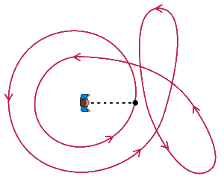
gestures instead of numbers:
winding numbers help prove the fundamental theorem of algebra:
Every polynomial equation
0 = a_{n}X^{n}+a_{n-1} X^{n-1}+...a₁X+a₀
has a solution in complex numbers

Slide 10
→
Gesture = digraph morphism g: Γ → (= Γ-addressed point) in spatial digraph X (= digraph of continuous curves I → X, I = [0,1])
of topological space X
X
→
body
skeleton
pitch
g
X
Γ
time
position

Slide 11
Morphisms between gestures
Let g: Γ → X and h: 𝚫 → Y be two gestures. A morphism f: g → h is a pair f = (u,v) of maps:
u: Γ → 𝚫 a digraph morphism (a map that sends vertices to vertices and arrows to arrows conserving their relations)
v: X → Y a continuous map which defines a corresponding digraph morphism v: X → Y sending curves c: I → X to curves v.c: I → X → Y.
Then we ask that the following square diagram of digraphs commutes:
→
→
→
→
→
g
h
→
Γ → X
𝚫 → Y
u v
→
→
→
→

Slide 12
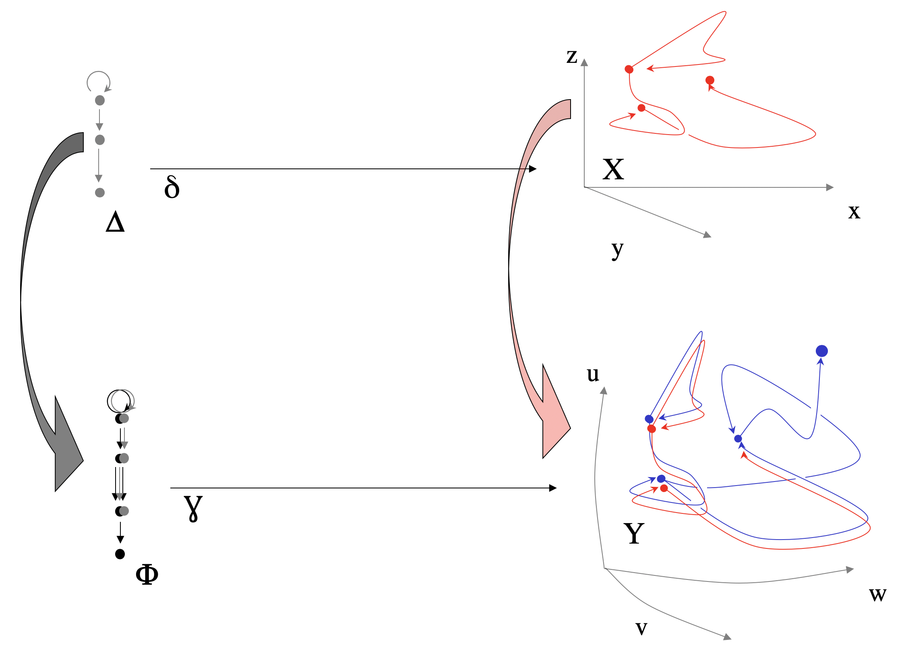
Complex Time
A morphism of gestures

Slide 13
Cavaillès and morphisms:
Understanding = catching the gesture and continuing:
gesture g;
catch g = morphism from gesture h (the subject who catches)
h —> g
Understanding g = look at all „catching actions“ This means: look at @g, i.e., all h@g (= {h—>g} ) This is Yoneda‘s lemma, i.e., g is completely understood through @g, through a complete „catching“.

Slide 14
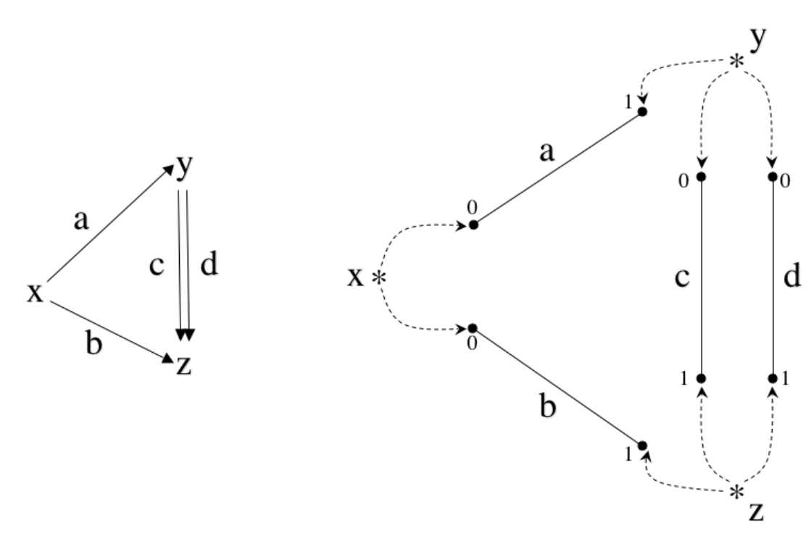
II.2 Natural Gestures
Every digraph 𝚫 generates a special gesture 𝚫, called natural gesture. Every arrow generates a straight line, these lines are connected according to the digraph‘s structure, and this defines a topological space |𝚫|.
→
→
𝚫
→
𝚫
|𝚫|

Slide 15
The natural gesture is the evident map
𝚫 : 𝚫 → |𝚫|.
The natural gesture has the following „universal“ property: For any gesture g: 𝚫 → X there is a continuous function |g|: |𝚫| → X, such that (Id, |g|): 𝚫 → g is a morphism of gestures (g and |g| are adjoint)
→
→
→
→
→
𝚫 → |𝚫|
X
→
→
→

Slide 16
II.3 Hypergestures

Slide 17
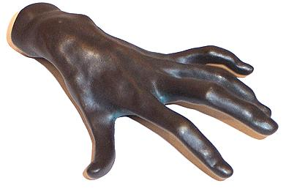
Space of gestures with skeleton Γ and body in X is a topological category.
Notation: Γ@X
→
gestures of gestures of....
= hypergestures!
pitch
tip space
realistic forms?
p
Γ
time
position

Slide 18
hypergesture
time
space
space
Space-time X

Slide 19
g
E
h
hypergesture impossible!

Slide 20
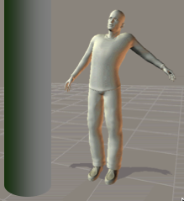
e
z
y
x

Slide 21
Definition and Existence
The set 𝚫@X of all gestures with skeleton 𝚫 and space X
is endowed with a natural structure of a topological space.
Intuitively, two gestures in this set are near to each other if their curves are near to each other in X.
This implies that we may consider gestures
g: Γ → 𝚫@X,
which defines the topological space
Γ@𝚫@X
of hypergestures (gestures of gestures).
→

Slide 22
The Escher Theorem
it states that there is a bijection,
Γ@𝚫@X ⥲ 𝚫@Γ@X
which conserves the topologies. More generally, if
Γ₁ , Γ₂ , Γ₃ ,... Γ_{n} is any sequence of digraphs, and if p is a permutation of the index set 1,2,3,...n, then there is a bijection
Γ₁@ Γ₂ @... Γ_{n} @X ⥲ Γ_{p(1)}@ Γ_{p(2)} @... Γ_{p(n)} @X
that conserves the two topologies.

Slide 23
II.3.1 Examples from Music:
Counterpoint
Beethoven‘s motif construction
Collaboration in performance

Slide 24
1. Counterpoint

Slide 25
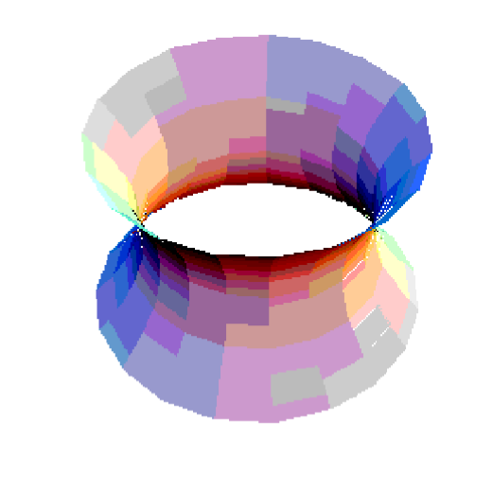

Slide 26
2. Beethoven‘s motif construction

Slide 27
Look at fanfare of Beethoven‘s op. 106 to understand rhythm!
1/8
1/8

Slide 28
repetition of halting gesture
halting of repetition gesture
halting gesture
repetition gesture

Slide 29
Solution: Complexification + Deformation
Lewin’s characteristic gesture
ρ“
i—
ρ
σ
Complexification exchanges duration/onset ~ repetition/halting!

Slide 30
3. Collaboration in performance

Slide 31
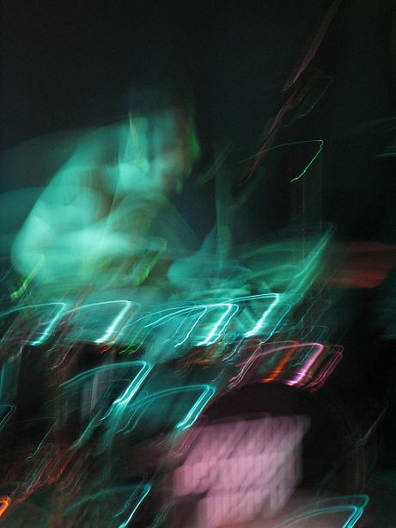
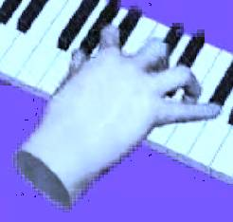
Problem: The discrete and the continuous... (Hatten et al.) Have often discrete sequence of events, gestures etc. in space-time. Connection?

Slide 32
II.3.2 Generalization: Topological Categories
A category C, which is also a topological space such that
composition of morphisms morph(C) x_{C} morph(C)—> morph(C): (u,v)~>u.v
identity morphism C —> morph(C): a~>Id_{a}
d,c: morph(C) —> C
are continuous.
Examples: a) 𝛁 = [0,1] with closed intervals [a ≤ b] as morphisms b) a topological space C with morph(C) = C² as morphisms

