Slide 1
I General Introduction
I.3 Present Gesture Theories
(We Jan 24)

Slide 2
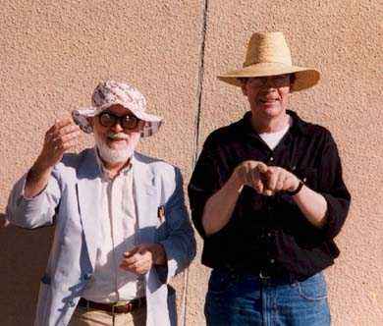
I.3.1 Psychological Gesture Theory (Adam Kendon & David Mac Neill)
Kendon then cites the Oxford English Dictionary (2nd edition 1989) where ‘gesture’ is defined as “a movement of the body, or any part of it, that is expressive of thought or feeling.”
He concludes:“ ‘Gesture’ we suggest, then, is a label for actions that have the features of manifest deliberate expressiveness.” The critical concept is ‘expressiveness’. Kendon makes this clear in his comment following that definition: “The more a movement shares these features (manifest deliberate expressiveness, G.M.), the more likely it is to be given privileged status in the attention of another an to be seen as part of the individual’s effort to convey meaning.”

Slide 3
Our reference to McNeill is his book “Gesture & Thought”. In the introduction, he defines the general scope of his theory:
Now [the emphasis] is how gestures fuel thought and speech.(...) Gesture, language, and thought are seen as different cognitive, and ultimately biological levels. (...) Gestures are active participants in speaking and thinking.
This makes clear that McNeill is restricting his gesture theory to gestures that are in different ways coexisting with language, this is also the reason he uses the concept of “language” in two ways: first as the linguistic phenomenon, and then in a larger sense—we might say: in a semiotic sense—as a system where the linguistic language is joined by the gestural part of language.
“To treat gestures in isolation from speech makes no more sense than to read a book by only looking at the ‘g’s.”

Slide 4
I.3.2 Creativity Theory
In Susan Goldin-Meadow’s book Hearing gesture: How our hands help us think, she investigates the role of gestures in the development of a child’s ability to reason mathematically. She writes:
Advances in mathematical reasoning are very likely to come first in gesture—and they do. (...) Do new ideas always come first in gesture, regardless of domain?

Slide 5
I.3.3 Gestural Embodiment: The French School
(Valéry, Cavaillès, Merleau-Ponty, Deleuze, Châtelet, Alunni)

Slide 6
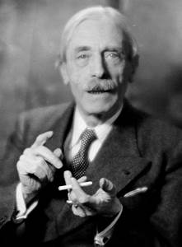
Paul Valéry, poet and philosopher (1871-1945)
Dans ces murs voués aux merveilles
J’accueille et garde les ouvrages
De la main prodigieuse de l’artiste
Égale et rivale de sa pensée
L’une n’est rien sans l’autre.
(At Paris’ Palais Chaillot:
In these walls devoted to the marvels I receive and keep the works of the artist’s prodigious hand equal and rival of his thought one is nothing without the other.)

Slide 7
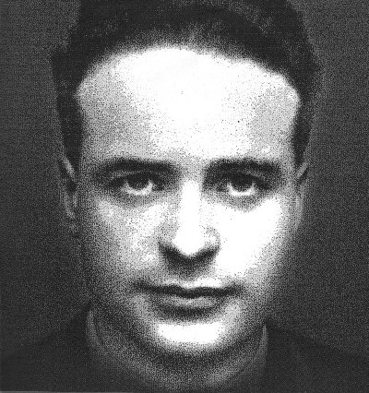
Jean Cavaillès, mathematician (1903-1944)
He summarizes the French philosophy of ges- tures in a concise way that entails heavy consequences for the entire conceptualization of the art of collaboration:
Understanding is catching the gesture and being capable of continuing.
So gestures are not just carriers for the transportation of contents, but elastic bodies that must be caught like balls in a game, and which require continuation in order to keep the game going.

Slide 8
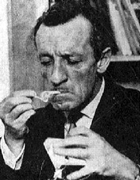
Maurice Merleau-Ponty, philosopher (1908-1961):
Merleau-Ponty advocates for an embodied consciousness, in incessant communication with the subject’s body. There cannot be, in Merleau-Ponty’s vision, a consciousness without a body, for the subject exists in the world precisely because of the body that allows itself and the consciousness to interact with their environment. This approach is strongly gestural and embodied.

Slide 9
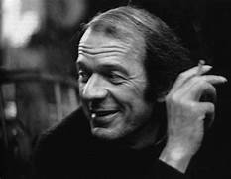
Gilles Deleuze, philosopher (1925-1995)
Deleuze’s 1981 work discusses Francis Bacon: La logique de la sensation, dealing with the painter’s sensational confessions made during David Sylvester’s Interview with Francis Bacon: The Brutality of Fact. In these reflections, Deleuze introduces what is now known as the pensée diagrammatique, the French school of gestural philosophy. Deleuze takes from Bacon’s statements the word “graph” and translates it to “diagramme” or even “geste”.

Slide 10
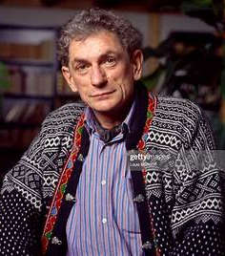
Gilles Châtelet, philosopher and mathematician (1944-1999)
He is very clear in this point:
Le concept de geste nous semble crucial pour approcher le mouvement d’abstraction amplifiante des mathématiques. (. . .) Un diagramme peut immobiliser un geste, le mettre au repos, bien avant qu’il ne se blottisse dans un signe, et c’est pourquoi les géomètres ou les cosmologistes contemporains aiment les diagrammes et leurs pouvoirs d’ évocation préemptoire.

Slide 11
(“The concept of a gesture seems crucial to approach the amplifying movememt of abstraction in mathematics. () A diagram can immobilize a gesture, put it to rest long before it is hidden in a sign, this is why geometers and contemporary cosmologists love diagrams and their power of preemptive evocation.”)

Slide 12
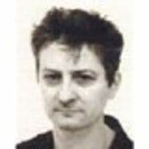
Charles Alunni, philosopher (?)
It is not the rule that governs the diagrammatic action, but the action that causes the rule to emerge.
Gestures not only make communication, but they “make sense”, make what will later be followed on the level of facticity. The rule, the law, that, which separates the truth from the false. Alunni’s step looks tiny, but it is the reversal of the old laws. Gestures are, in Alunni’s approach, the law-makers, not the ornaments of established truths.

Slide 13
I.3.4 Gestural Embodiment: Anglo-Saxon Approaches
(Donald, Smolin, Penrose, Witten)

Slide 14
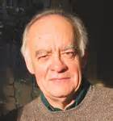
Merlin Donald, Australian anthropologist (1939- )
Donald maintains that mirror neurons offer a basic mechanism for a cultural mimesis thesis:
Most importantly, the fundamentals of articulatory gesture, from which all languages are built, were put in place when mimetic capacity emerged.
Donald’s anthropological perspective considers the body’s nonverbal communication as an embryonic form of high culture’.

Slide 15
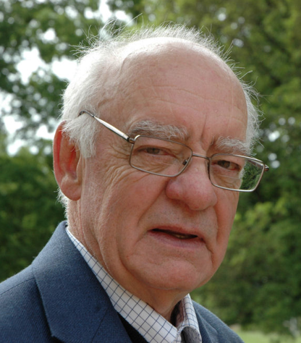
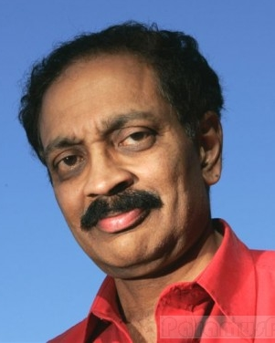
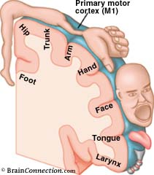
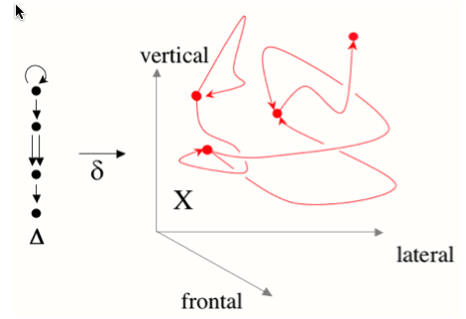
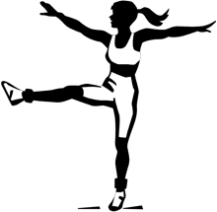
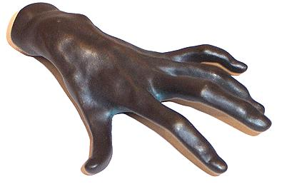
Mirror-Neurons in anthropology and cognitive science:
Anthropolgist Merlin W. Donald: cultural human evolution via gestural memesis.
Neurologist Vilayanur S. Ramachandran: Mirror neuron „resonance“ plays in psychology the role of DNA copying in molecular biology.
?
Body & Environment
Homunculus
Gestures
Cognition
LANGUAGE
Perhaps one should proceed in the other direction: First the simplest transformations of thoughts to gestures, then the difficult ones.
mirror neurons
LOGIC
(A & B) ⇒ C
MATHEMATICS
X² + 2X-3 = 0

Slide 16
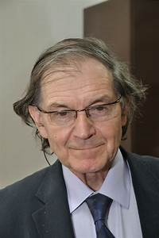
Roger Penrose, mathematical physicist (1931- ), Nobel prize winner 2020
Penrose’s thoughts about human consciousness opens up a window to the question of how time could be a constructive entity. The impact of this situation in physics is that the quasi-objective reality of physics is missing a fundamental understanding of the nature of time. Penrose and Lee Smolin are by no means exotic physicists, the are only the first to realize that physics is more than a bunch of objects and experiments floating around in a divine space-time theater.

Slide 17
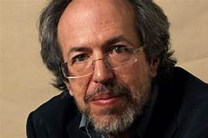
Lee Smolin, physicist (1955- )
One further aspect of consciousness is the fact that it takes place in time. Indeed, when I assert that it is always some time in the world, I am extrapolating from the fact that my experiences of the world always take place in time. But what do I mean by my experiences? I can speak about them scientifically as instances of recordings of information. To speak so, I need not mention consciousness or qualia. But this may be an evasion, because these experiences have aspects that are consciousness of qualia. So my conviction that what is real is real in the present moment is related to my conviction that qualia are real.

Slide 18
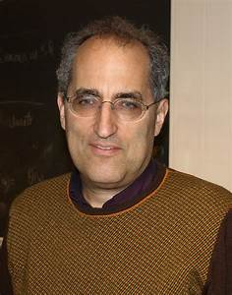
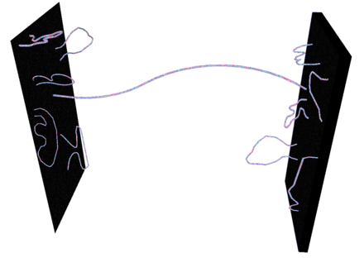
Edward Witten, mathematical physicist (1951- ) Fields medal 1990
String theory, where Witten is a prominent scholar, is a theoretical framework in which the point-like particles of particle physics are replaced by one-dimensional objects called strings, a kind of gestures in physics. String theory describes how these strings propagate through space and interact with each other. On distance scales larger than the string scale, a string looks just like an ordinary particle, with its mass, charge, and other properties determined by the vibrational state of the string. In string theory, one of the many vibrational states of the string corresponds to the graviton, a quantum mechanical particle that carries gravitational force.

