Slide 1
I General Introduction
I.2 Historical, Cultural, Neuroscience Roots
(Mo Jan 22)

Slide 2
I.2.1 Historical/Philosophical Roots
(Plato, Aristoteles, Lao Tse, Confucius, St Victor)

Slide 3
Plato, Aristoteles
In ancient Greek philosophy, there were two concepts of time:
1. chronos, the linear time that is controling our trajectory
in this world‘s reality
2. kairos, the time of human presence.

Slide 4
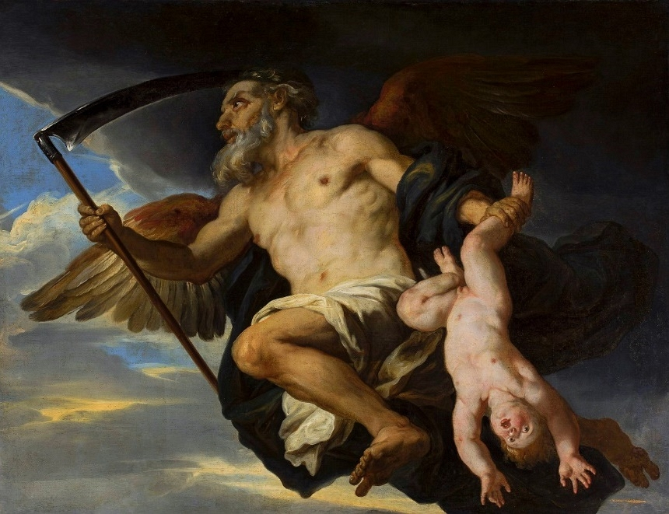
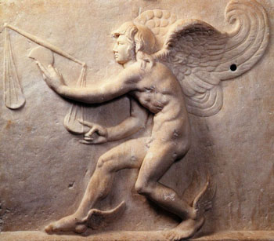
1. chronos, the linear time that is controling our trajectory
in this world‘s reality, humans are passive in this reality.
2. kairos, the time of human presence, a gestural concept.
chronos
kairos

Slide 5
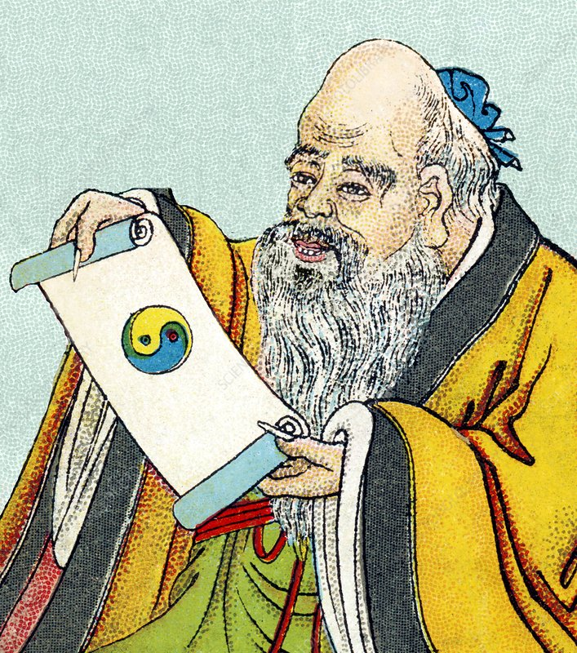
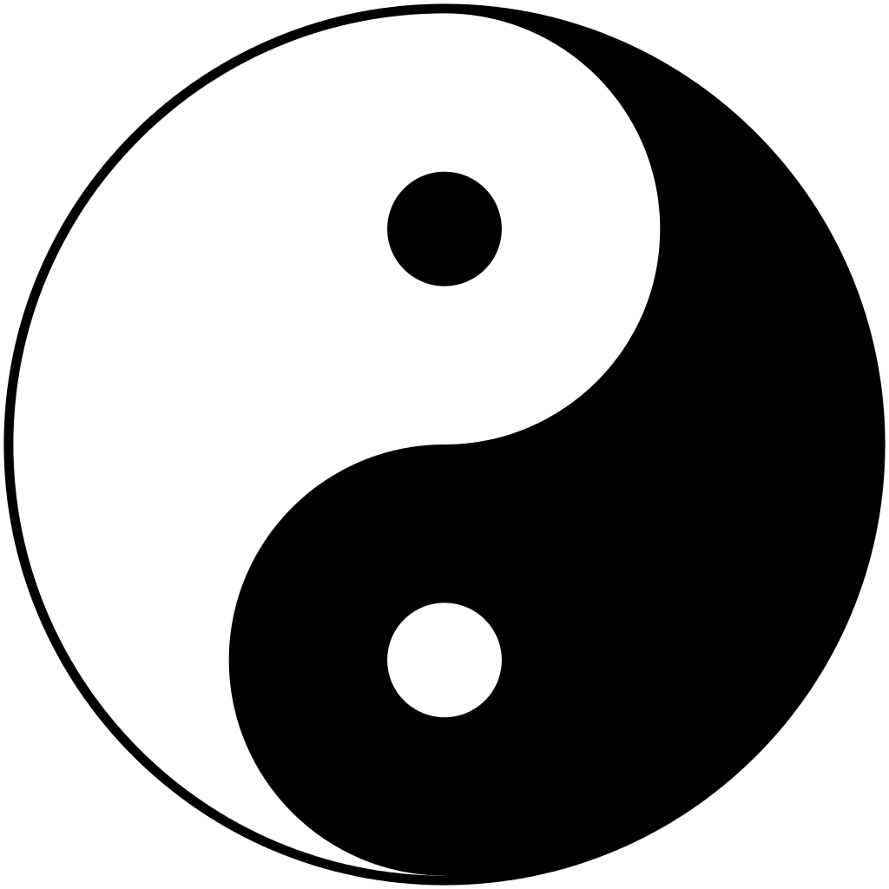
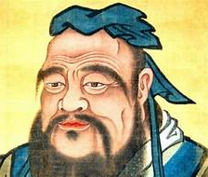
Lao Tse, Confucius: Lao Tse‘s principle of Yin and Yang of an incessant processuality between these two polar forces implies that “time” is not a concept and is instead replaced by “process”, a gestural category.
Confucius: The Chinese duration is a concept that refers to the transition from moment to moment. This transitional reality is a kind of deepened moment, not its negation. It views time as a gestural interaction of objects, not as an abstract parameter.
Lao Tse
Confucius

Slide 6
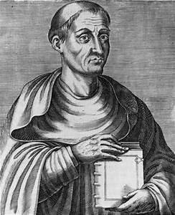
Hugue de St Victor, a French theologist (1096-1141). He defined a first time the concept of a gesture:
Gestus est motus et figuratio membrorum corporis, ad omnem agenda et habendi modum.
Gesture is the movement and figuration of the body‘s limbs with an aim, but also according to the measure and modality proper to the achievment of all action and attitude.
(Translation by Roman Katsman)

Slide 7
I.2.3 Neuroscience
(Mirror neurons, 3D mental rotation.)

Slide 8
Mirror Neurons
Maurizio Gentilucci and Michael C. Corballis have proposed a theory of gradual transition from manual gesture to speech:
„It is supposed that speech is itself a gestural system rather than an acoustic system, an idea captured by the motor theory of speech perception and articulatory phonology. Studies of primate premotor cortex and, in particular, of the so-called „mirror system“ suggest a double hand/mouth command system that may have evolved initially in the context of ingestion, and later formed a platform for combined manual and vocal communication.

Slide 9
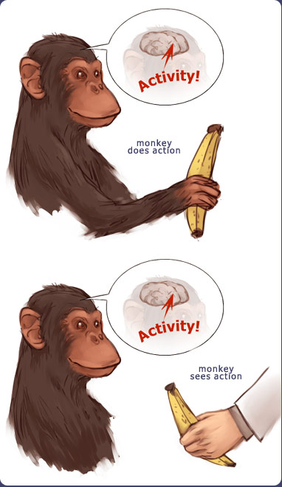
Giacomo Rizzolatti and collaborators 1992, University of Parma. These neurons were discovered in the ventral cortex von macacca monkeys:
“The fundamental characteristic of these neurons was that they discharged both when the monkey performed a certain motor act (e.g., grasping an object) and when it observed another individual (monkey or human) performing that or a similar motor act.” (Rizzolatti G. and M. Fabbri-Destro: Mirror neurons: from discovery to autism. Exp. Brain Res. 200: 223-237, 2010.)
Mirror Neurons:
activity
monkey acts
activity
monkey sees action

Slide 10
„In humans, speech is typically accompanied by manual gesture, speech production itself is influenced by executing or observing hand movements, and manual actions also play an important role in the development of speech, from the babbling stage onwards.“
The premotor cortex lies above Broca's area, which is responsible for the speech production, as opposed to Wernicke's area, which takes care of speech perception.

Slide 12
3D mental rotation The spatial competence was chosen to be the mental 3D rotation competence of spatial objects as first investigated by Shepard and Cooper.
This competence means the velocity and accuracy of being able to decide, whether two 3D objects are a rotational displacement (rotation plus translation) of each other or a rotational displacement of the mirror image of each other.

Slide 13
Lynn A. Cooper and Roger N. Shepard (U Pittsburg/U Stanford 1978): 3DMR = Three dimensional mental rotation
Hypergestures!
We perform mental rotations, i.e. gestural curves between the shapes

Slide 14
It was shown in the Cooper-Shepard experiments that the comparison of such spatial objects was effectively performed by their mental, i.e., virtual rotation (3DMR = 3D Mental Rotation). This indicates that the comparison of two spatial objects is realized by a motor action: moving them around in a mental space. We compare shapes by a very common gestural action: taking the objects in our hands and move them around.

